Slide 1

The creative side of the scientific process
Itai Yanai
Martin Lercher
CEO: Oliver Bogler
Night Science Institute
Train the Trainer Workshop, 9/30/2026
Notes:
The slides in this slide deck are largely based on the Night Science publications by Itai Yanai & Martin Lercher.
Links to the PDFs of the publications are listed on https://night-science.org/home/learn/read/ .

Slide 2
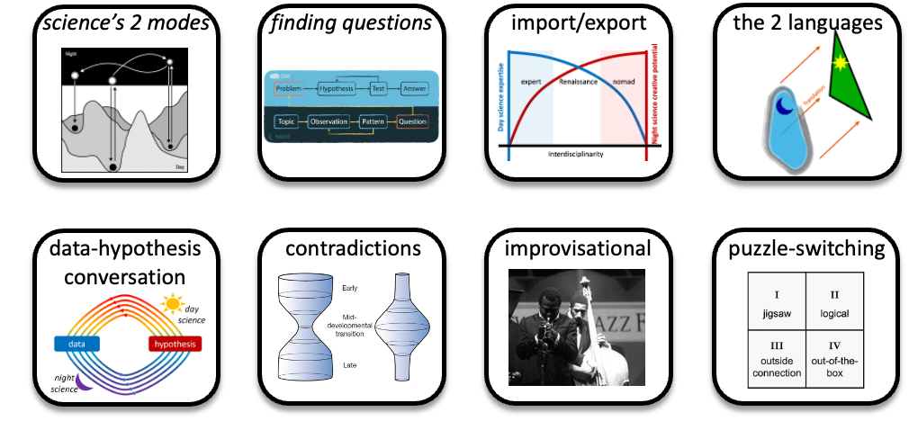
Night Science – Train the Trainer
September 30, 2026 – EMBL Heidelberg
Part 1 (10:00-11:00) – An overview of the creative process & the Night Science initiative
Break (11:00-11:30) – Meet your workshop buddy
Part 2 (11:30-12:45) – Leading a Night Science session
Lunch (12:45-13:45)
Part 3a (13:45-15:15) – 7 additional thinking tools covered in the Night Science Workshop (Part 1)
Break (15:15-15:30)
Part 3b (15:30-16:45) – 7 additional thinking tools covered in the Night Science Workshop (Part 2)
Break (16:45-17:00)
Part 4 (17:00-18:00) – Night Science Activation Energy: How to get started
2

Slide 3

Oliver Bogler, CEO of the Night Science Institute www.night-science.org
Notes:
Oliver Bogler, the CEO of the Night Science Institute, organized the Train-the-Trainer event. He also helped shape the current slide deck.
Before joining the Night Science Institute, Dr. Bogler was a cancer researcher and tenured professor at VCU and MD Anderson, and he served for 5 years at NCI as the Director of the Center for Cancer Training.

Slide 4

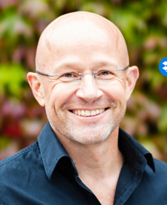
Itai Yanai
Professor of Biochemistry at New York University, School of Medicine
Undergraduate degrees: Engineering & Philosophy of Science
PhD in Bioinformatics, Boston Univ.
Postdocs at Weizmann & Harvard
Expertise:
  Cancer biology and host-pathogen interactions
  Evolutionary & devel. biology
  Single-cell & spatial RNA-Seq
  Computational biology
Martin Lercher
  Professor of Computational Cell Biology, Heinrich Heine University Düsseldorf, Germany
  Undergraduate degree: Physics
  PhD in Theoretical Physics, Cambridge
  Postdocs at Bath, EMBL Heidelberg
  Expertise:
  Biophysical computer models of microbes and plants
  AI predictions of protein-small molecule interactions
  Evolutionary genomics
Notes:
The Night Science workshop/course was developed by Itai Yanai & Martin Lercher.
Both are university professors and active researchers in the biosciences.
For both of them, their original training was in a different field of science – one of the features that can help with the creative scientific process.

Slide 5
Part 1
An overview of the creative scientific process & the Night Science initiative

Slide 6

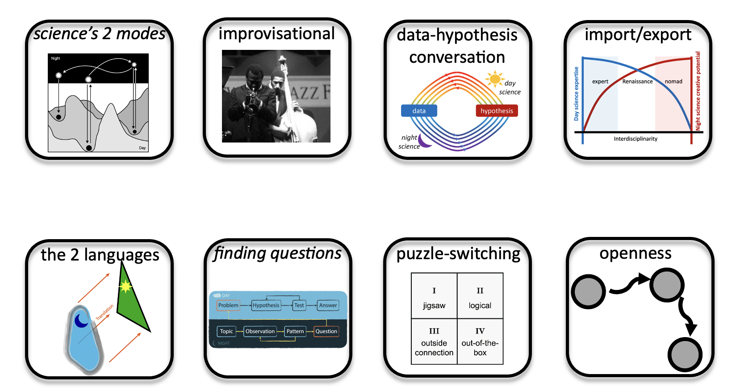
Night Science
The creative side of the scientific process
Night Science | Day Science The Tools
Notes:
To teach and to learn the tools of Night Science, it’s best to include hands-on exercises – this is why we consider it a workshop rather than a lecture series.

Slide 7

What do we want?

Slide 8
Getting stuck

Slide 9
The pattern is that in every project there comes a CRISIS
CRISIS

Slide 10
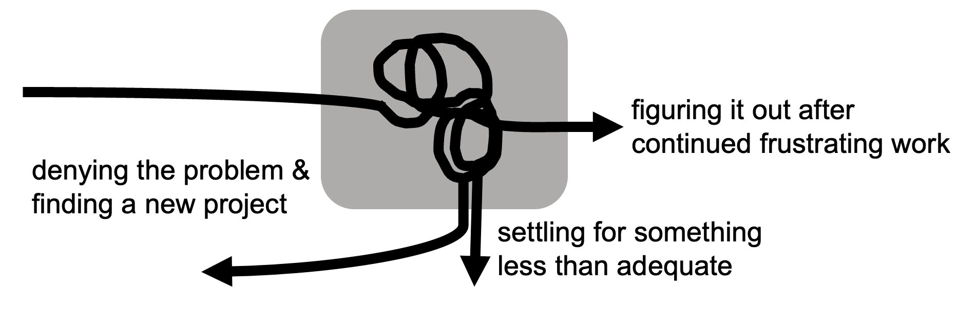
The pattern is that in every project there comes a CRISIS
David Sapp’s “Point of Creative Frustration Model” (1992)
CRISIS

Slide 11
Science in the making:
What do you do when you’re stuck?
CRISIS

Slide 12
Science in the making:
What do you do when you’re stuck?

Slide 13
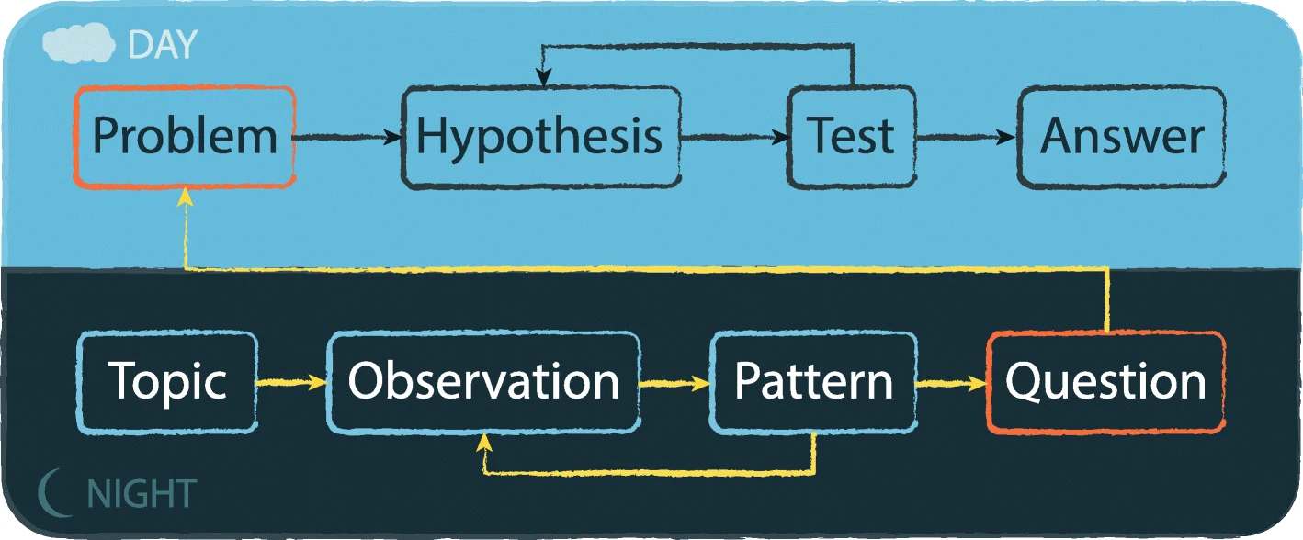
How does science work?
Notes:
Most people learn how science works early on in school:
You start with a problem and form a hypothesis about how the problem could be solved.
You then collect empirical data and test if it is consistent with the predictions that arise from the hypothesis.
If all data appears to be consistent with the hypothesis, than we accept the hypothesis as an answer – always allowing for the possibility that later data will refute it.
If it is not consistent, we have to replace or modify the hypothesis.
This is what most people – including many active researchers – consider the scientific process.

Slide 14
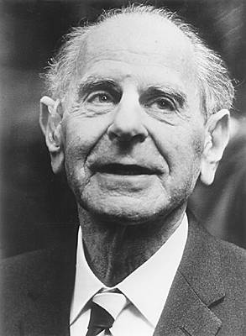
Karl Popper and Falsification
Notes:
This view of the scientific process was formalized by philosophers of science, perhaps most clearly by Sir Karl Popper.
Popper called the underlying method falsificationism.
If we investigate the real world, we can never prove that something is true – we can only prove that something is wrong, we can falsify it.
While there are many subtleties to this interpretation of science, falsificationism forms the basis of how scientific knowledge is confirmed.
So according to what most of us have learned about the scientific process and to what many philosophers of science say, researchers get up every morning to kill another beautiful hypothesis. But are we really?

Slide 15
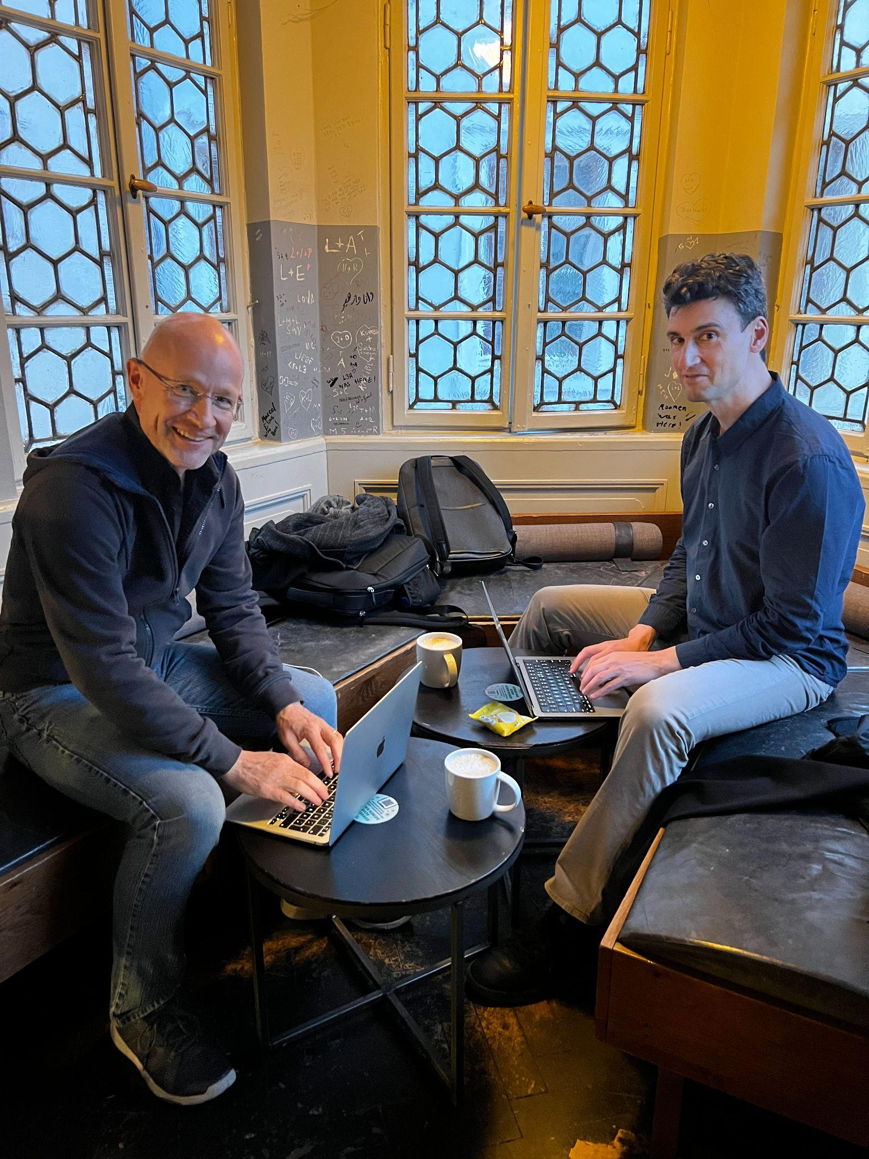
This is how science works..
Is it, though?
Notes:
However, this description of the scientific process is incomplete.
Itai and Martin like to tell an anecdote about how it first dawned on them that something was missing – maybe you can remember a corresponding anecdote from your own research history!
The picture shows Itai & Martin in the alcove of their favorite coffee shop in Heidelberg, Germany.
Itai and Martin first met at the European Molecular Biology Lab (EMBL) in Heidelberg.
While doing a project together, they became aware of some very interesting data that was freely available on the internet: the first transcriptomes – the frequency of mRNA copies made from all the different genes in the genomes – for different tissues in human and mouse.
They were convinced that they could discover something interesting about biology from comparing those transcriptomes.
They started off by statistical analyses, which they performed on their laptops, preferentially sitting in the alcove shown above. That was the scientific process as they had been taught.
However, often the answers where not what they expected.
Again and again, they were confused. Sometimes, they didn’t even know anymore what the question was and how to proceed.
At the time, it felt like “just” a failed project.
Only later did they realize that this uncertainty, the confusion, and the associated frustration are an integral part of the scientific process.

Slide 16
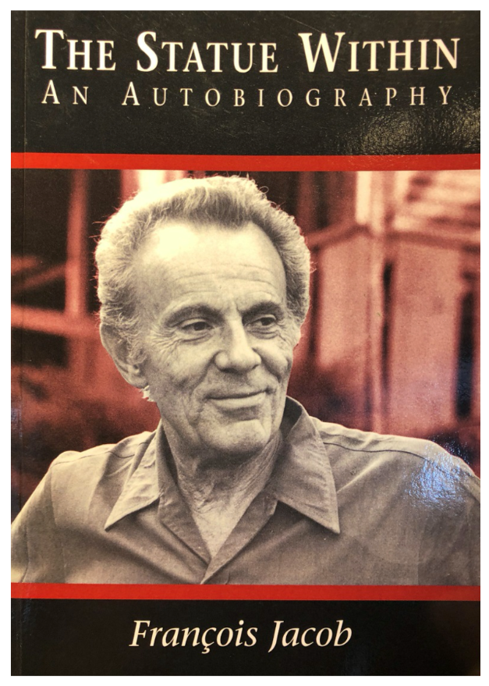
François Jacob (1920-2013), discoverer of
principles of gene regulation
“Science in the works has two aspects: what could be called Day Science and Night Science.”
Notes:
Many scientists have equally realized that something is missing from the standard description of the scientific creative process.
However, there is very little formal literature about this – you’re more likely to find accounts of the missing part in autobiographies than in scientific publications.
A beautiful example can be found in the autobiography of François Jacob (1920 – 2013), who shared the 1965 Nobel Prize in Physiology or Medicine with Jacques Monod and André Lwoff "for their discoveries concerning genetic control of enzyme and virus synthesis" for his work on the lac operon.
Day Science is what Popper talks about: the testing of ideas in an attempt to falsify them.

Slide 17
François Jacob (1920-2013), discoverer of
principles of gene regulation
“Science in the works has two aspects: what could be called Day Science and Night Science.”
“Night Science wanders blind. It hesitates, stumbles, recoils, sweats, wakes with a start. Doubting everything, it is forever trying to find itself, question itself, pull itself back together. Night science is a sort of workshop of the possible where what will become the building material of science is worked out.”
Notes:
Night Science, on the other hand, is the chaotic, free, anything-goes process where new ideas are slowly formed.
Note that day and night here are metaphors. While for Jacob, the time for Night Science was indeed the night, we can (and should) do Day Science and Night Science at any time of day.

Slide 18
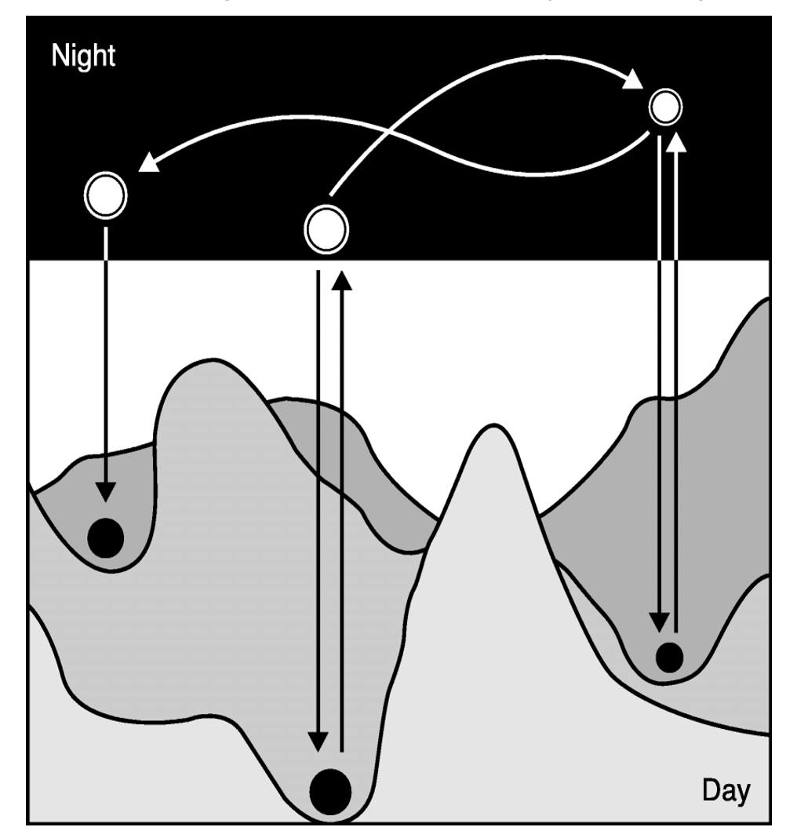
The scientific process includes periods of
Day Science & Night Science
Notes:
As active scientists, we continuously switch between the two processes of the complete scientific method.
In Day Science, we perform experiments, take measurements, and test ideas.
We move in a highly structured landscape, restricting what experiments are accessible and realistic, and what can be concluded from them.
From time to time, we pop out into the realm of Night Science to generate new ideas and solutions.
Here, there are no limits. We can freely use our intuition, metaphors, sloppy language, inaccurate mappings to other fields – all that matters is that we have a new idea.
Once a new idea is formed, we can carry it back to Day Science to test it.

Slide 19
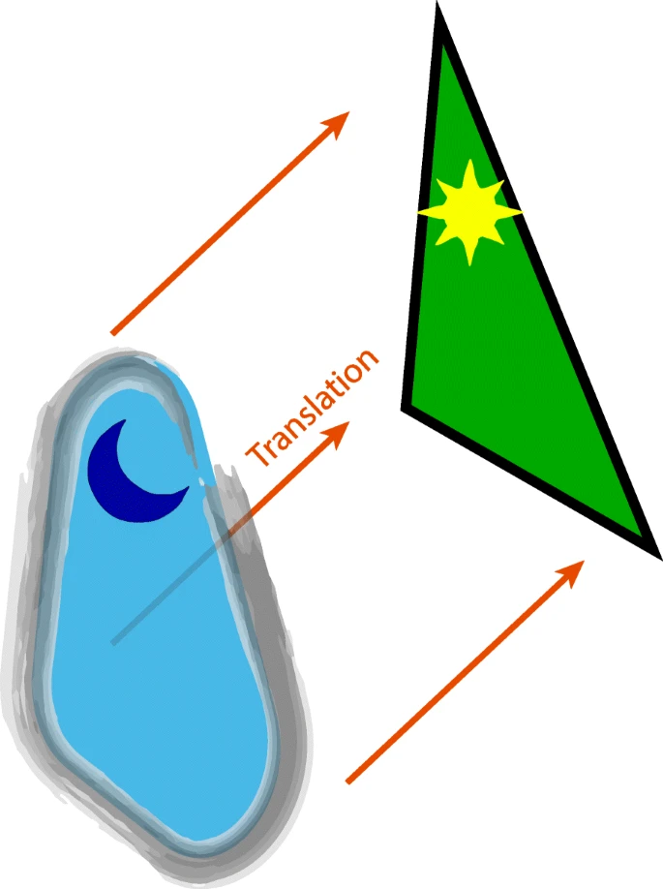
The night/day dichotomy has been described across fields
Context of discovery Context of justification
Philosophers of Science (Reichenbach, 1938 )
Notes:
This dichotomy between a rigorous, executive day process and a creative, free night process was not discovered by Jacob for the first time.
It appears to be fundamental to many – maybe all – of human endeavours.
The dichotomy has been described again and again across fields.
Philosophers of science talk about the context of discovery (Night Science) and the context of justification (Day Science)
(Reichenbach, H. (1938). Experience and prediction. Chicago, IL: University of Chicago Press).

Slide 20
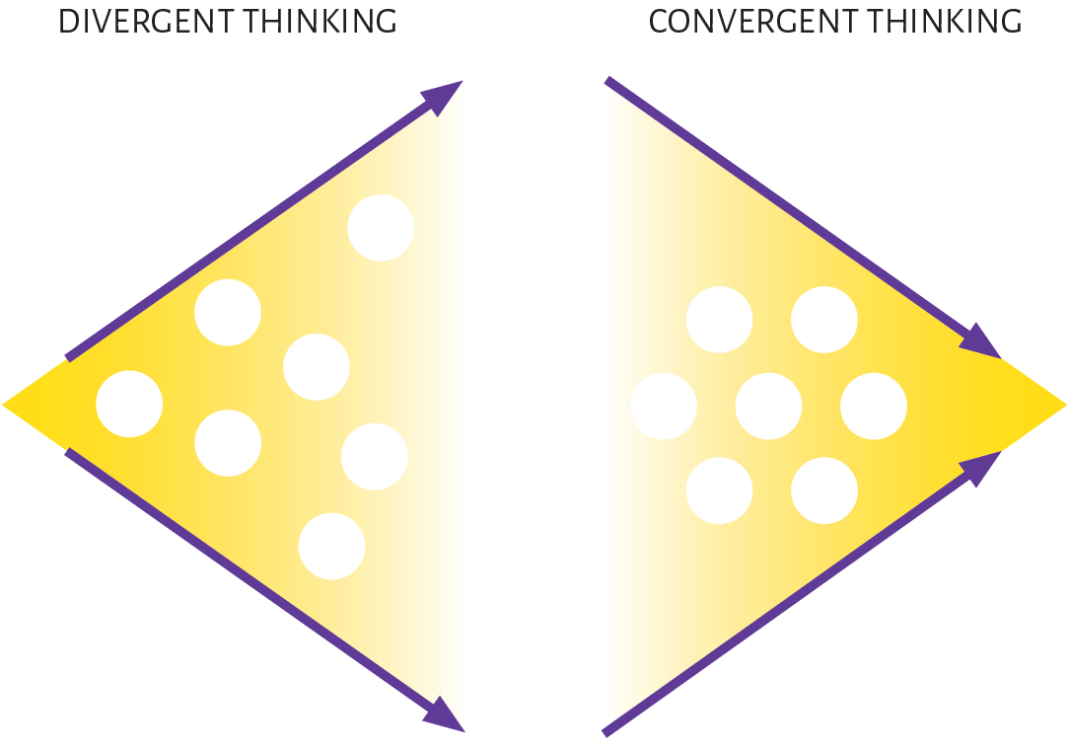
The night/day dichotomy has been described across fields
Divergent thinking Convergent thinking
Psychology (Guilford, 1956)
Notes:
Similarly, psychologists talk about divergent thinking, where multiple ideas are generated (Night Science), and convergent thinking, where we zoom in on the “best” idea (Day Science)
(Guilford, J. P. (1956). The structure of intellect. Psychological Bulletin, 53(4), 267-293).

Slide 21
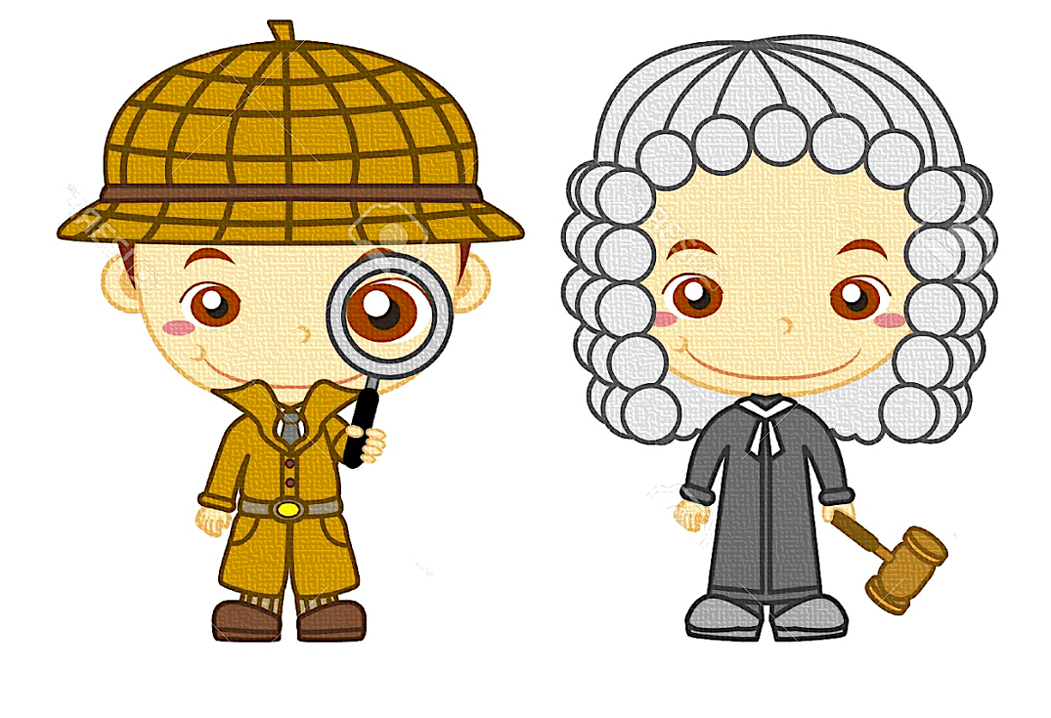
Detective Judge
The night/day dichotomy has been described across fields
Statistics (Tukey, 1977)
Notes:
To describe the two occupations of statisticians, John Tukey has used the analogy of the detective, who performs exploratory data analyses (Night Science), and the judge, who decides if some observation is likely to be meaningful or spurious (Day Science)
(Tukey, J. W. (1969). Analyzing data: Sanctification or detective work? American Psychologist, 24(2), 83–91. https://doi.org/10.1037/h0027108).

Slide 22
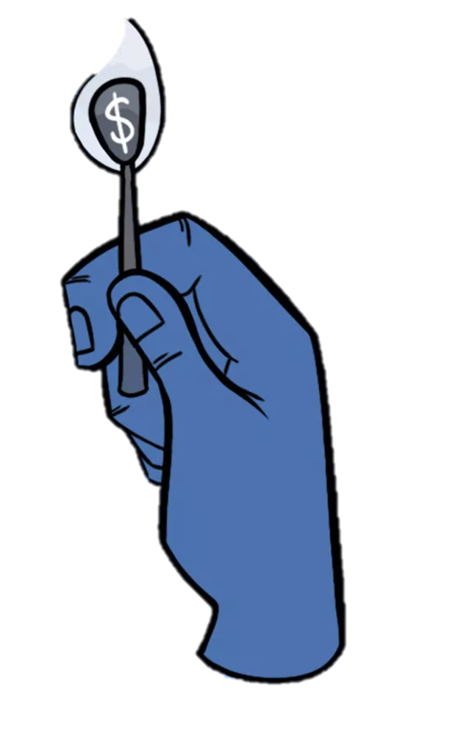

The night/day dichotomy has been described across fields
Start-up Corporate
Entrepreneurship (Blank, 2012)
Notes:
The dichotomy can also be found in entrepreneurship: many early start-ups are still in search of their exact business model (Night Science), while corporations focus on the executive part of business (Day Scinece)
(Blank, Steve, and Bob Dorf. The startup owner's manual: The step-by-step guide for building a great company. John Wiley & Sons, 2020).

Slide 23
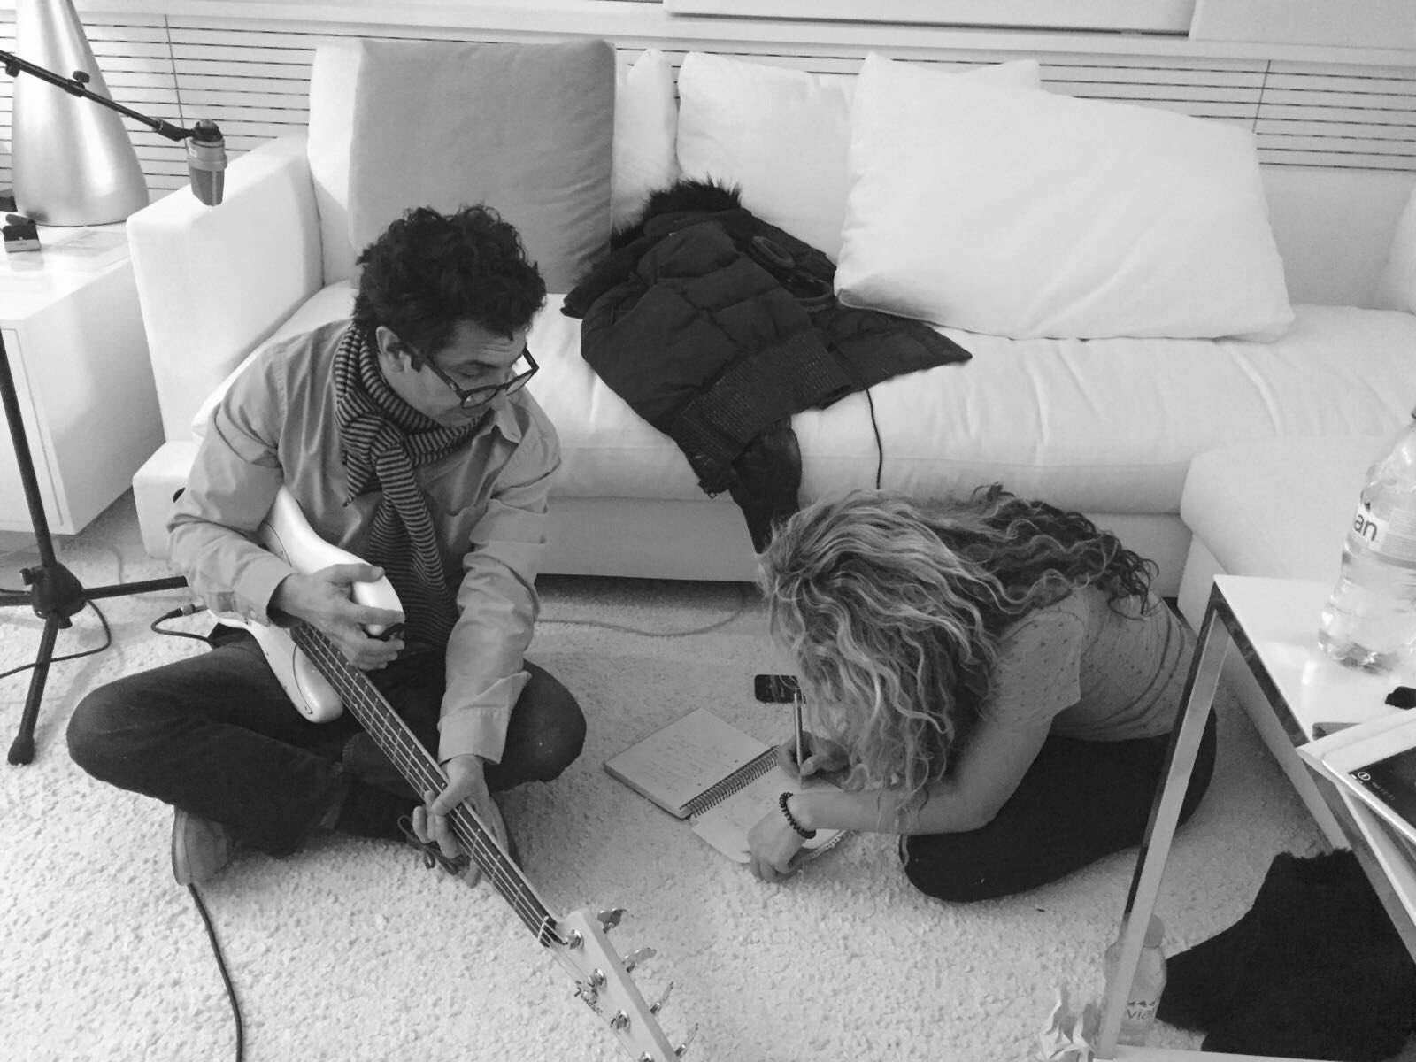

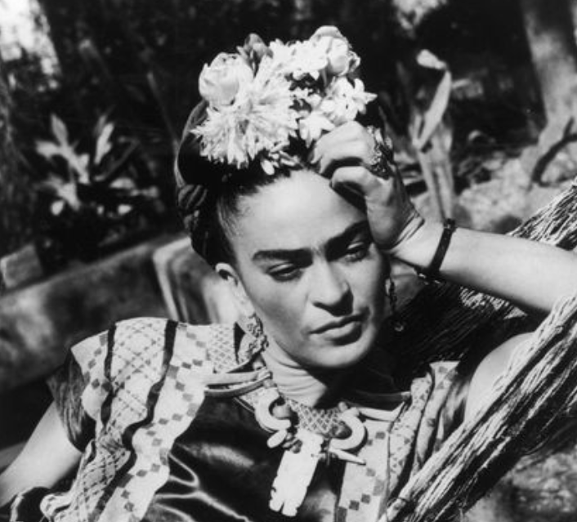
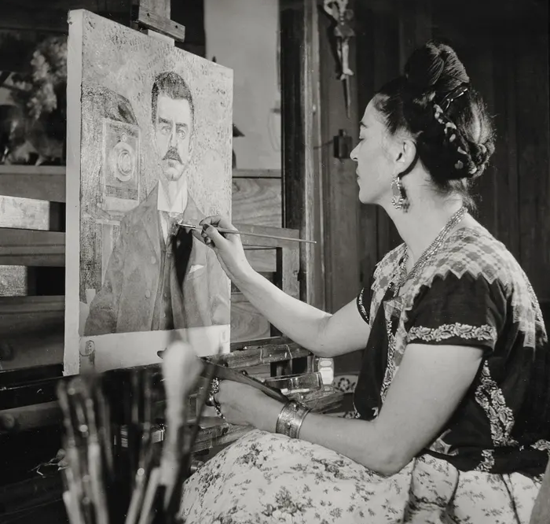
The night/day dichotomy is shared with the arts
Night Music
Day Music
Music:
Shakira
Night Painting
Day Painting
Art:
Frida Kahlo
Notes:
The dichotomy between a creative Night process and an executive Day process is also shared with the arts.
When an artist like Shakira stands on a stage and performs a song, she and everyone in the band knows exactly what note to sing or play at what time – this is Day Music (even if some artists also improvise during performances, which adds a Night Music element).
But before a song can be performed, it has to be invented: what is the song’s story? What is its emotion? What images could be used? What chord sequence, what melody? This creative and often intuitive process could be called Night Music.
Very similar arguments can be made for paining.

Slide 24
The two complementary minds needed for the scientific process
Night Science Day Science
Process: | Open (evolution) | Closed (exp. design)
Mode: | Improvisational | Falsification
Compartmentalization: | Interdisciplinary | Disciplinary
Puzzle-state: | Puzzle-switching | Solution-testing
Goal: | Hypothesis-generating | Hypothesis-testing
Language: | Metaphorical | Precise
Logic: | Questions & Contradictions | Consistent Answers
Dimensionality: | Jump between planes | Stay on one plane
Notes:
This table provides a quick overview over the topics covered in the workshop sessions – each line corresponds to one session.
In this session, we explored the general dichotomy between the two subprocesses of the scientific process: the creative Night Science mode and the executive Day Science mode.

Slide 25
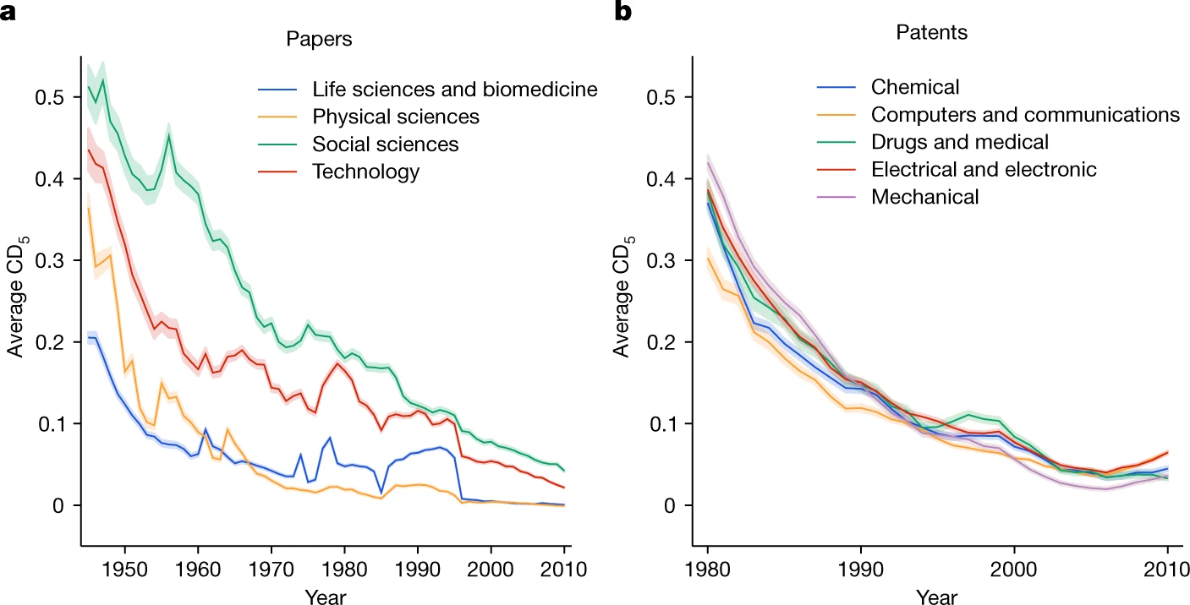
Problem: There is evidence that science is becoming less creative
Science has become more results-oriented and hypothesis-driven
This leaves less room for exploratory and creative approaches
Young scientists are not trained in being creative
Papers
Patents
Park, Leahey & Funk, Nature 2023
Disruptiveness

Slide 26
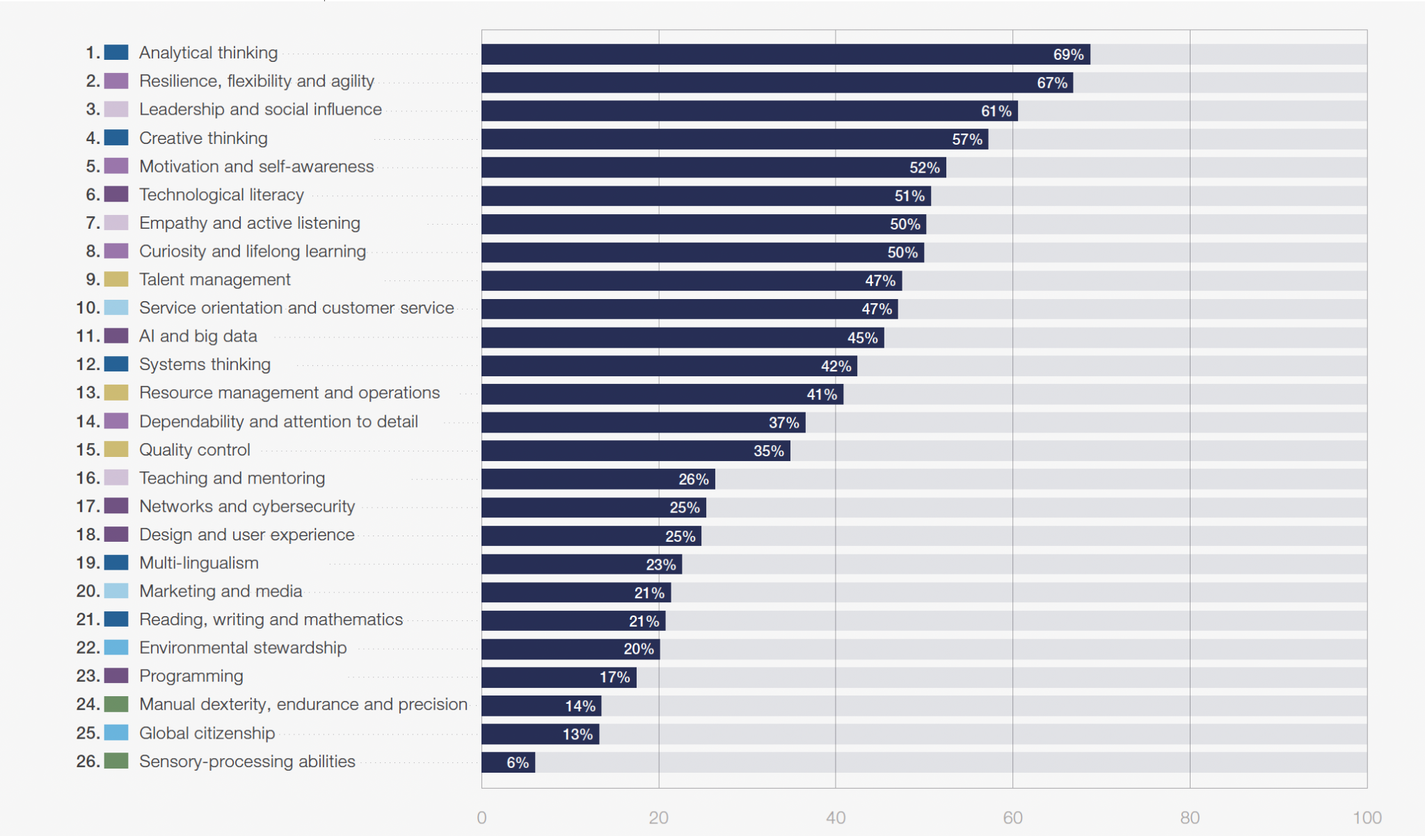
World Economic Forum: Core Skills in 2025
Creative
thinking
Share of employers (%) who consider the stated skill to be a core skill for their workforce
Future of Jobs Report 2025

Slide 27
Why isn’t creativity taught?
Myth 1: People are born either creative or uncreative.
Myth 2: Creativity is intertwined with negative aspects of psychology & society.
Myth 3: Creativity is a fuzzy, soft construct.
Myth 4: Creativity is enhanced within a group.
Myth 5: We have no idea how to teach it.
Plucker, Beghetto & Dow, Educational Psychologist 39:83 (2004)

Slide 28
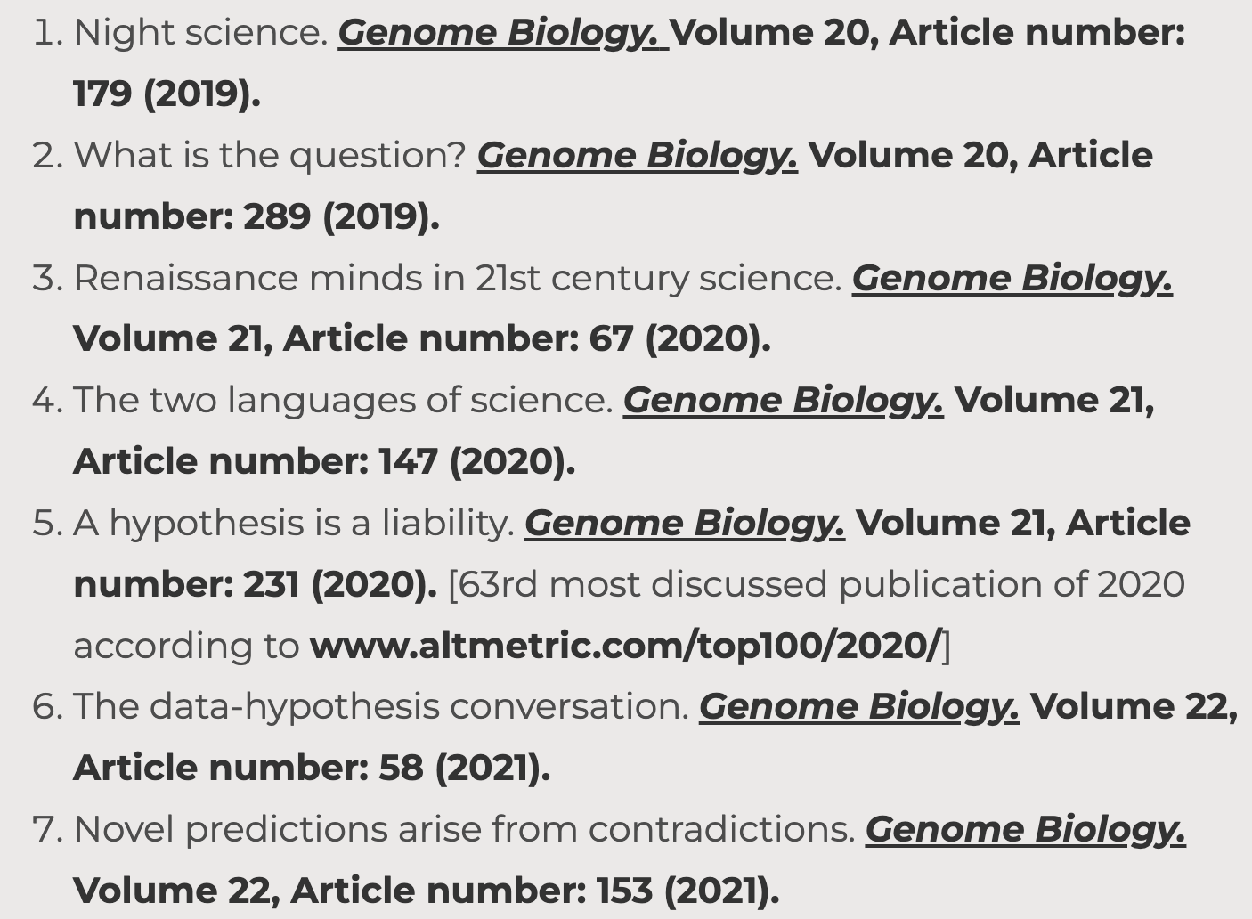
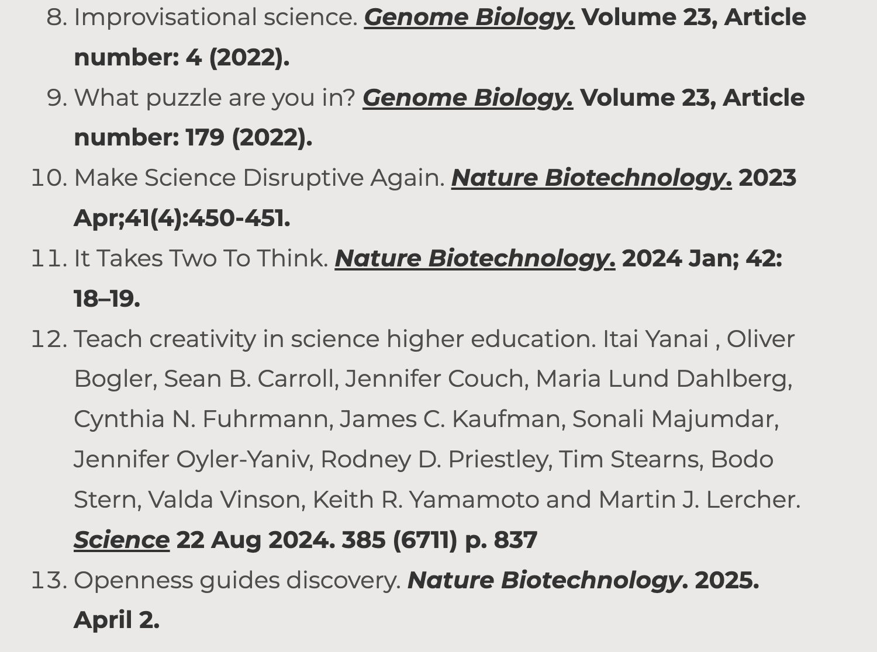

What are the tools of the creative process in science?
The Night Science Institute
www.night-science.org
Notes:
This is an overview over the Night Science pieces published by Itai and Martin.

Slide 29
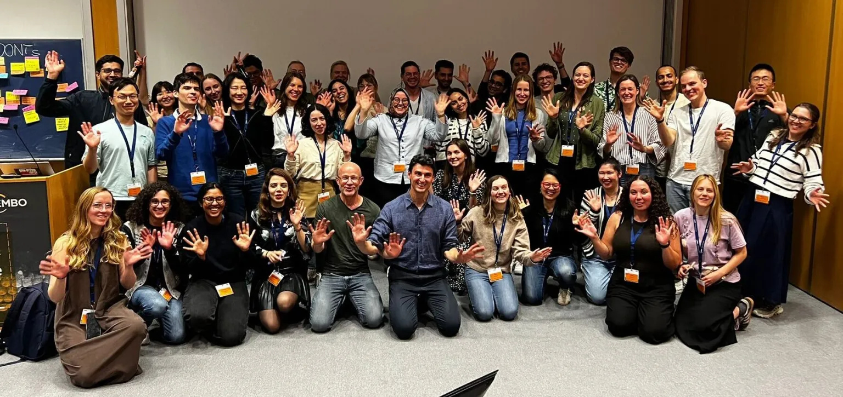
Workshop attendees at the EMBO YIN PhD course, May 2025
Notes:
As a logical conclusion from the insights about the creative scientific process, Itai & Martin developed a Night Science workshop.
This workshop has been taught at dozens of universities, research institutes, and research-oriented companies in the US and Europe.
The picture shows the participants of one example: the Young Investigator PhD course of EMBO, the European Molecular Biology Organization, in May 2025.

Slide 30
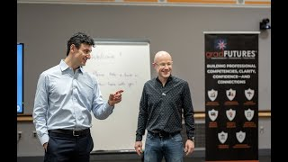
A Workshop on the Creative Side of the Scientific Process
January 23-24th 2023, Princeton

Slide 31
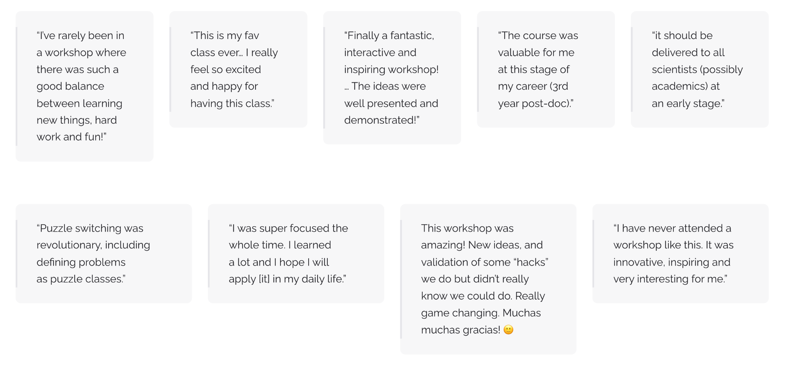
Reviews from the Night Science Workshop

Slide 32
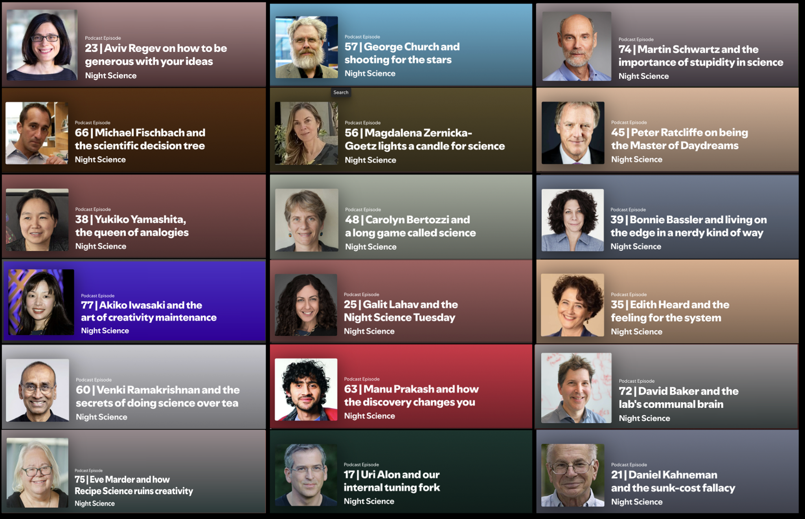

The Night Science Podcast
Notes:
The Night Science podcast, hosted by Itai & Martin, explores the personal approaches to scientific creativity of a diverse set of amazing researchers.
The podcast focuses on the process of doing science, not on the particular topics and results of its guests.
You can find the episodes wherever you listen to podcast, or access them here:
https://night-science.org/home/learn/listen/

Slide 33
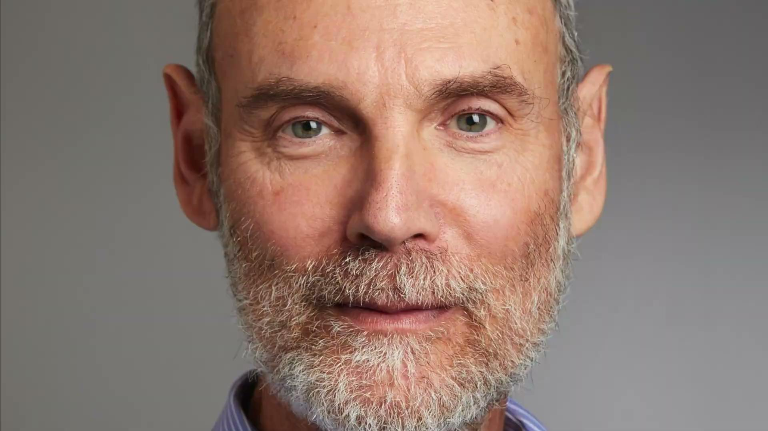
The Night Science Podcast – Episode 74 with Martin Schwartz
Notes:
This is an excerpt of the Night Science Podcast episode 74 with Martin Schwartz, Robert W. Berliner Professor of Medicine (Cardiology) and Professor of Biomedical Engineering and of Cell Biology at Yale.

Slide 34
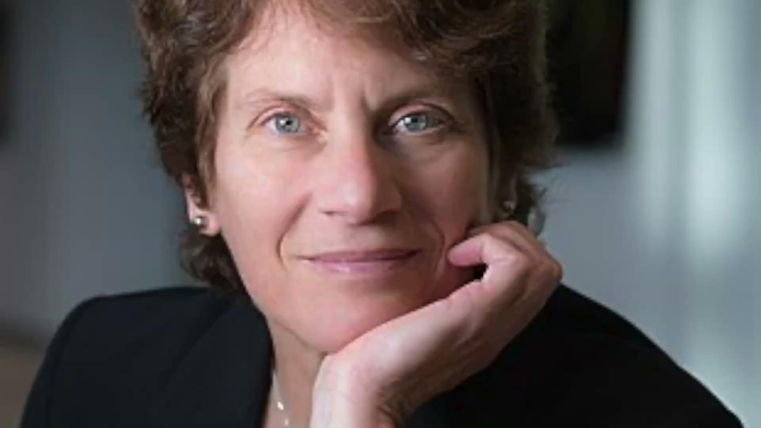
The Night Science Podcast – Episode 48 with Carolyn Bertozzi
Notes:
This is an excerpt of the Night Science Podcast episode 48 with Carolyn Bertozzi, Anne T. and Robert M. Bass Professor at Stanford University and Investigator at the Howard Hughes Medical Institute.
Carolyn Bertozzi was awarded the Nobel Prize in Chemistry in 2022 (jointly with Morten P. Meldal and Karl Barry Sharpless, for the development of click chemistry and bioorthogonal chemistry).

Slide 35
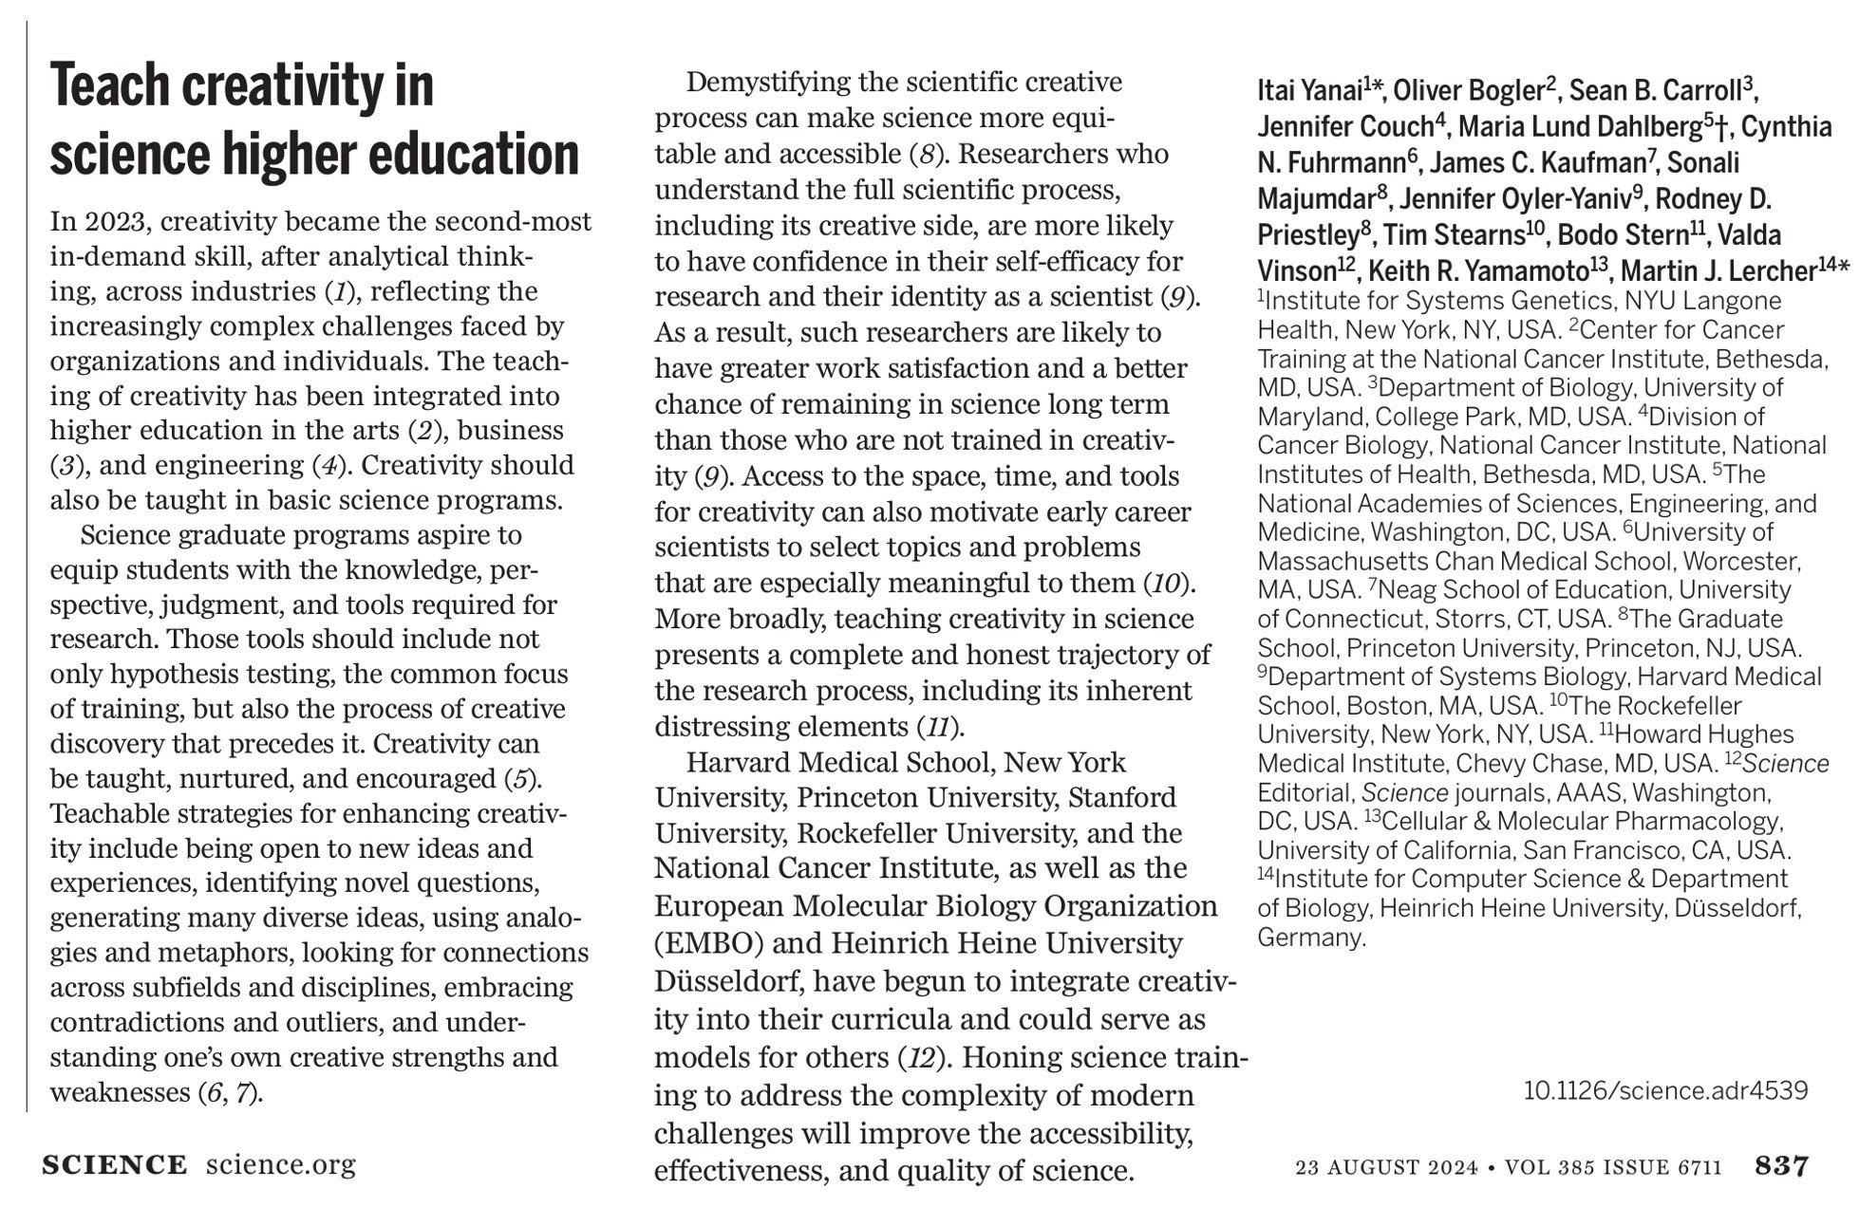
The Night Science mission
Notes:
This editorial in the journal Science resultet from the Summit on the Creative Scientific Process that Itai & Martin organized at the Radcliffe Institute for Advanced Study at Harvard University
The co-authors and attendees at the summit are stakeholders in scientific research from universities, funding agencies, and publishers.

Slide 36
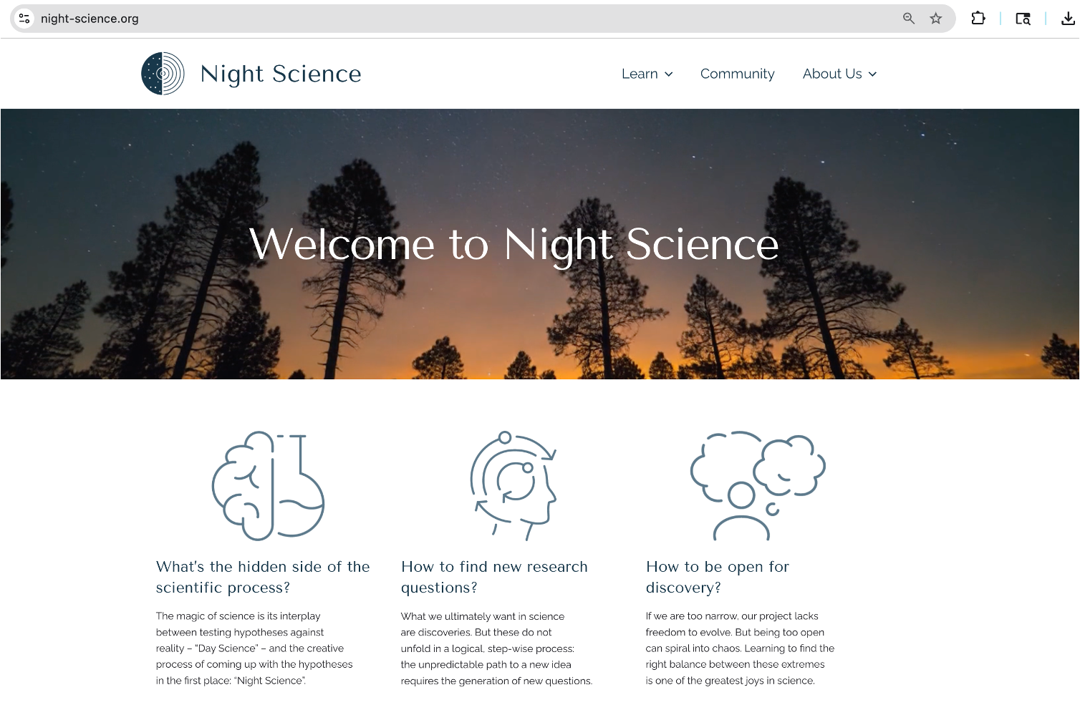
www.night-science.org
Notes:
The Night Science activities are now bundled at the Night Science Institute and can be accessed through its web site.

Slide 37
What is this ‘Train the Trainer’ about?
How together, we change the culture of science!
What? Teaching the process and the tools
Why? For more discoveries and better satisfaction in our time doing science
Where? At your home institute – and anywhere!
When? During courses, group meetings, retreats
How? This event will get you ready to teach it

Slide 38
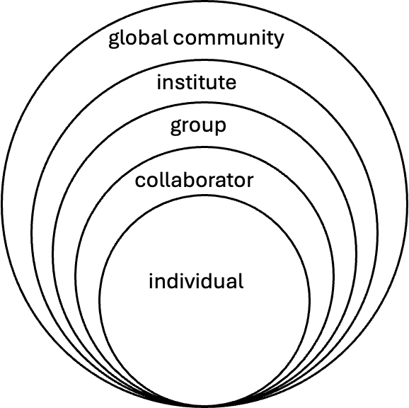
A vision for improving the culture of science

Slide 39
Openness guides discoveries
Yanai & Lercher: Openness guides discovery. Nature Biotech 43:667 (2025)
Notes:
This session takes a macro-view of the evolution of a scientific project.
Openness is the one personality trait and habit that is consistently associated with creativity.
The session contents are largely based on the article “Openness guides discovery” by Itai & Martin:
https://www.nature.com/articles/s41587-025-02635-7

Slide 40
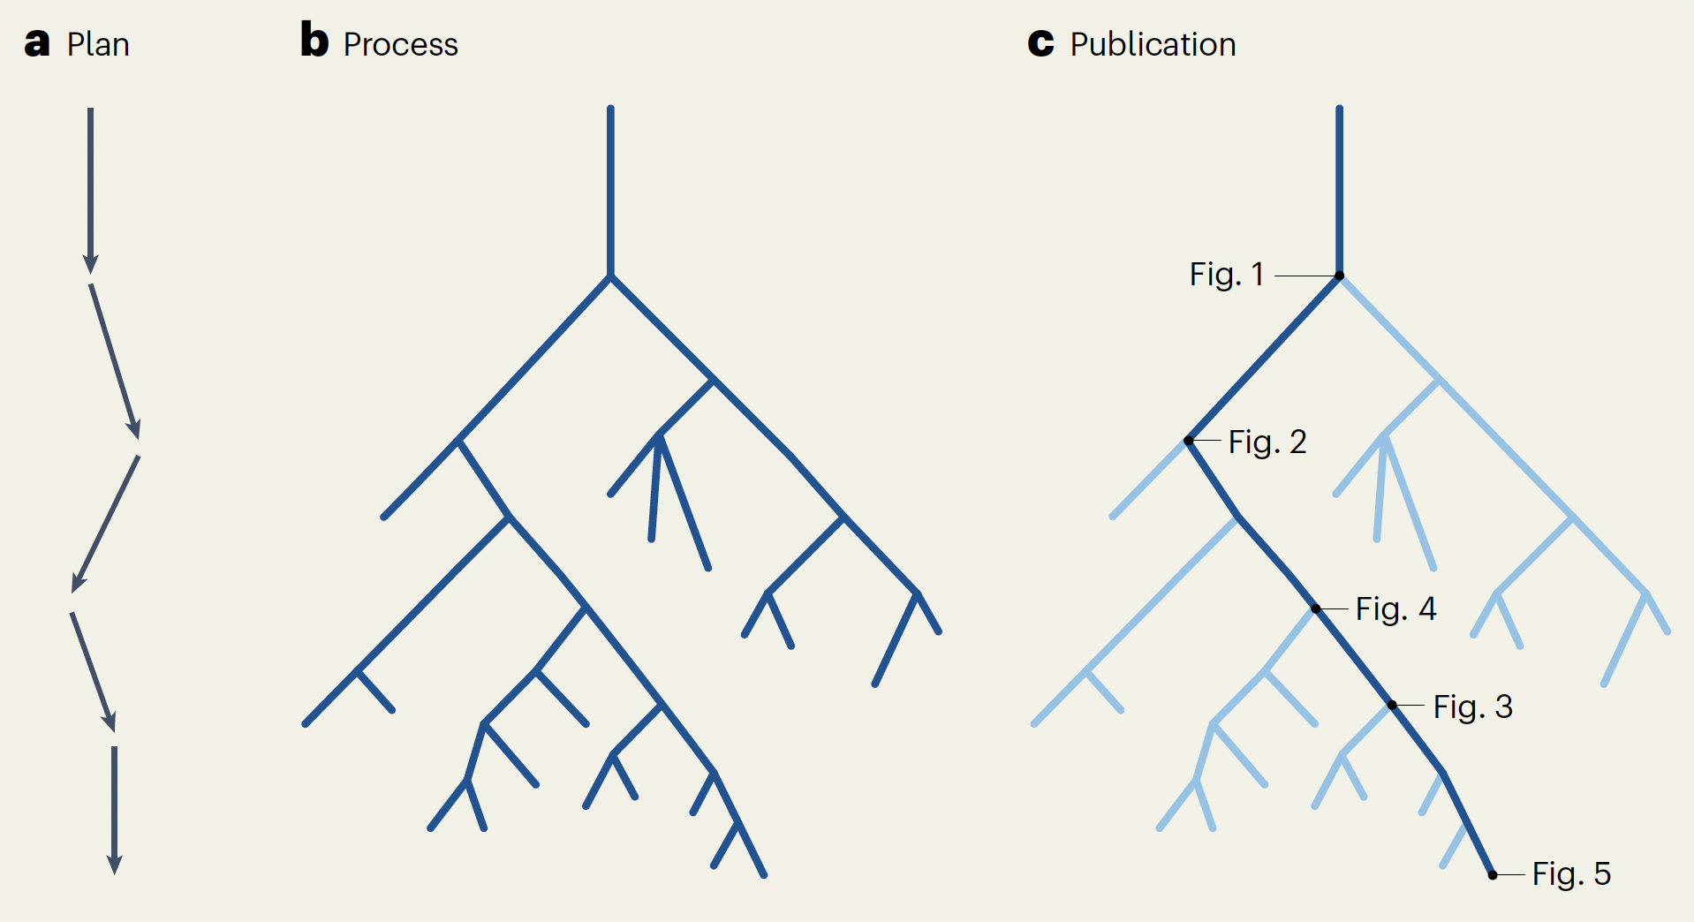
Funding agencies & thesis committees require elaborate research plans for a project’s progress
Plan
Notes:
Funding agencies & thesis committees require elaborate research plans for a project’s progress.
We are expected to lay out in detail what we’ll be doing over the next 2-5 years:
“Based on a hypothesis we formed from reading the literature, we will do this.
At the end of year 1, we will have result x.
Based on this, we will do this in year 2, which will result in y.
…
These research plans are linear: we pretend that before we even start, we know the nature of our discovery.

Slide 41
But science in the making evolves
Plan Process
Notes:
But this linearity is pure fantasy.
In reality, research project evolve.
We start off in a linear fashion, but then quickly we get to a point where we find something unexpected and have to make a decision.
We try one thing – one path – and get to the next decision, and so on.
Often, we trace back our steps and try another direction.
In the end, we will have generated an evolutionary tree that connects all the things we tried out in the project – most of which probably didn’t lead anywhere interesting.

Slide 42
Why don’t papers look like this?
Plan Process Publication
Notes:
When we read the story of a project recounted in its publication, it again looks linear.
“We hypothesized this. To test this, we first did x. This led us to next do y. To test the reliability of our results, we additionally did z. …”
How is this possible if projects do not evolve in a linear fashion?

Slide 43
Publications describe the discovery as it ideally should have happened – if it could have been predicted
Plan Process Publication
Notes:
The solution is simple: scientific papers are not historical accounts of everything that was done in a project.
Instead, they just recount the most interesting path through the tree – the one that led to the discovery.
Thus, if early-career scientsist read papers to try to understand how research is done, they will get the wrong idea.

Slide 44
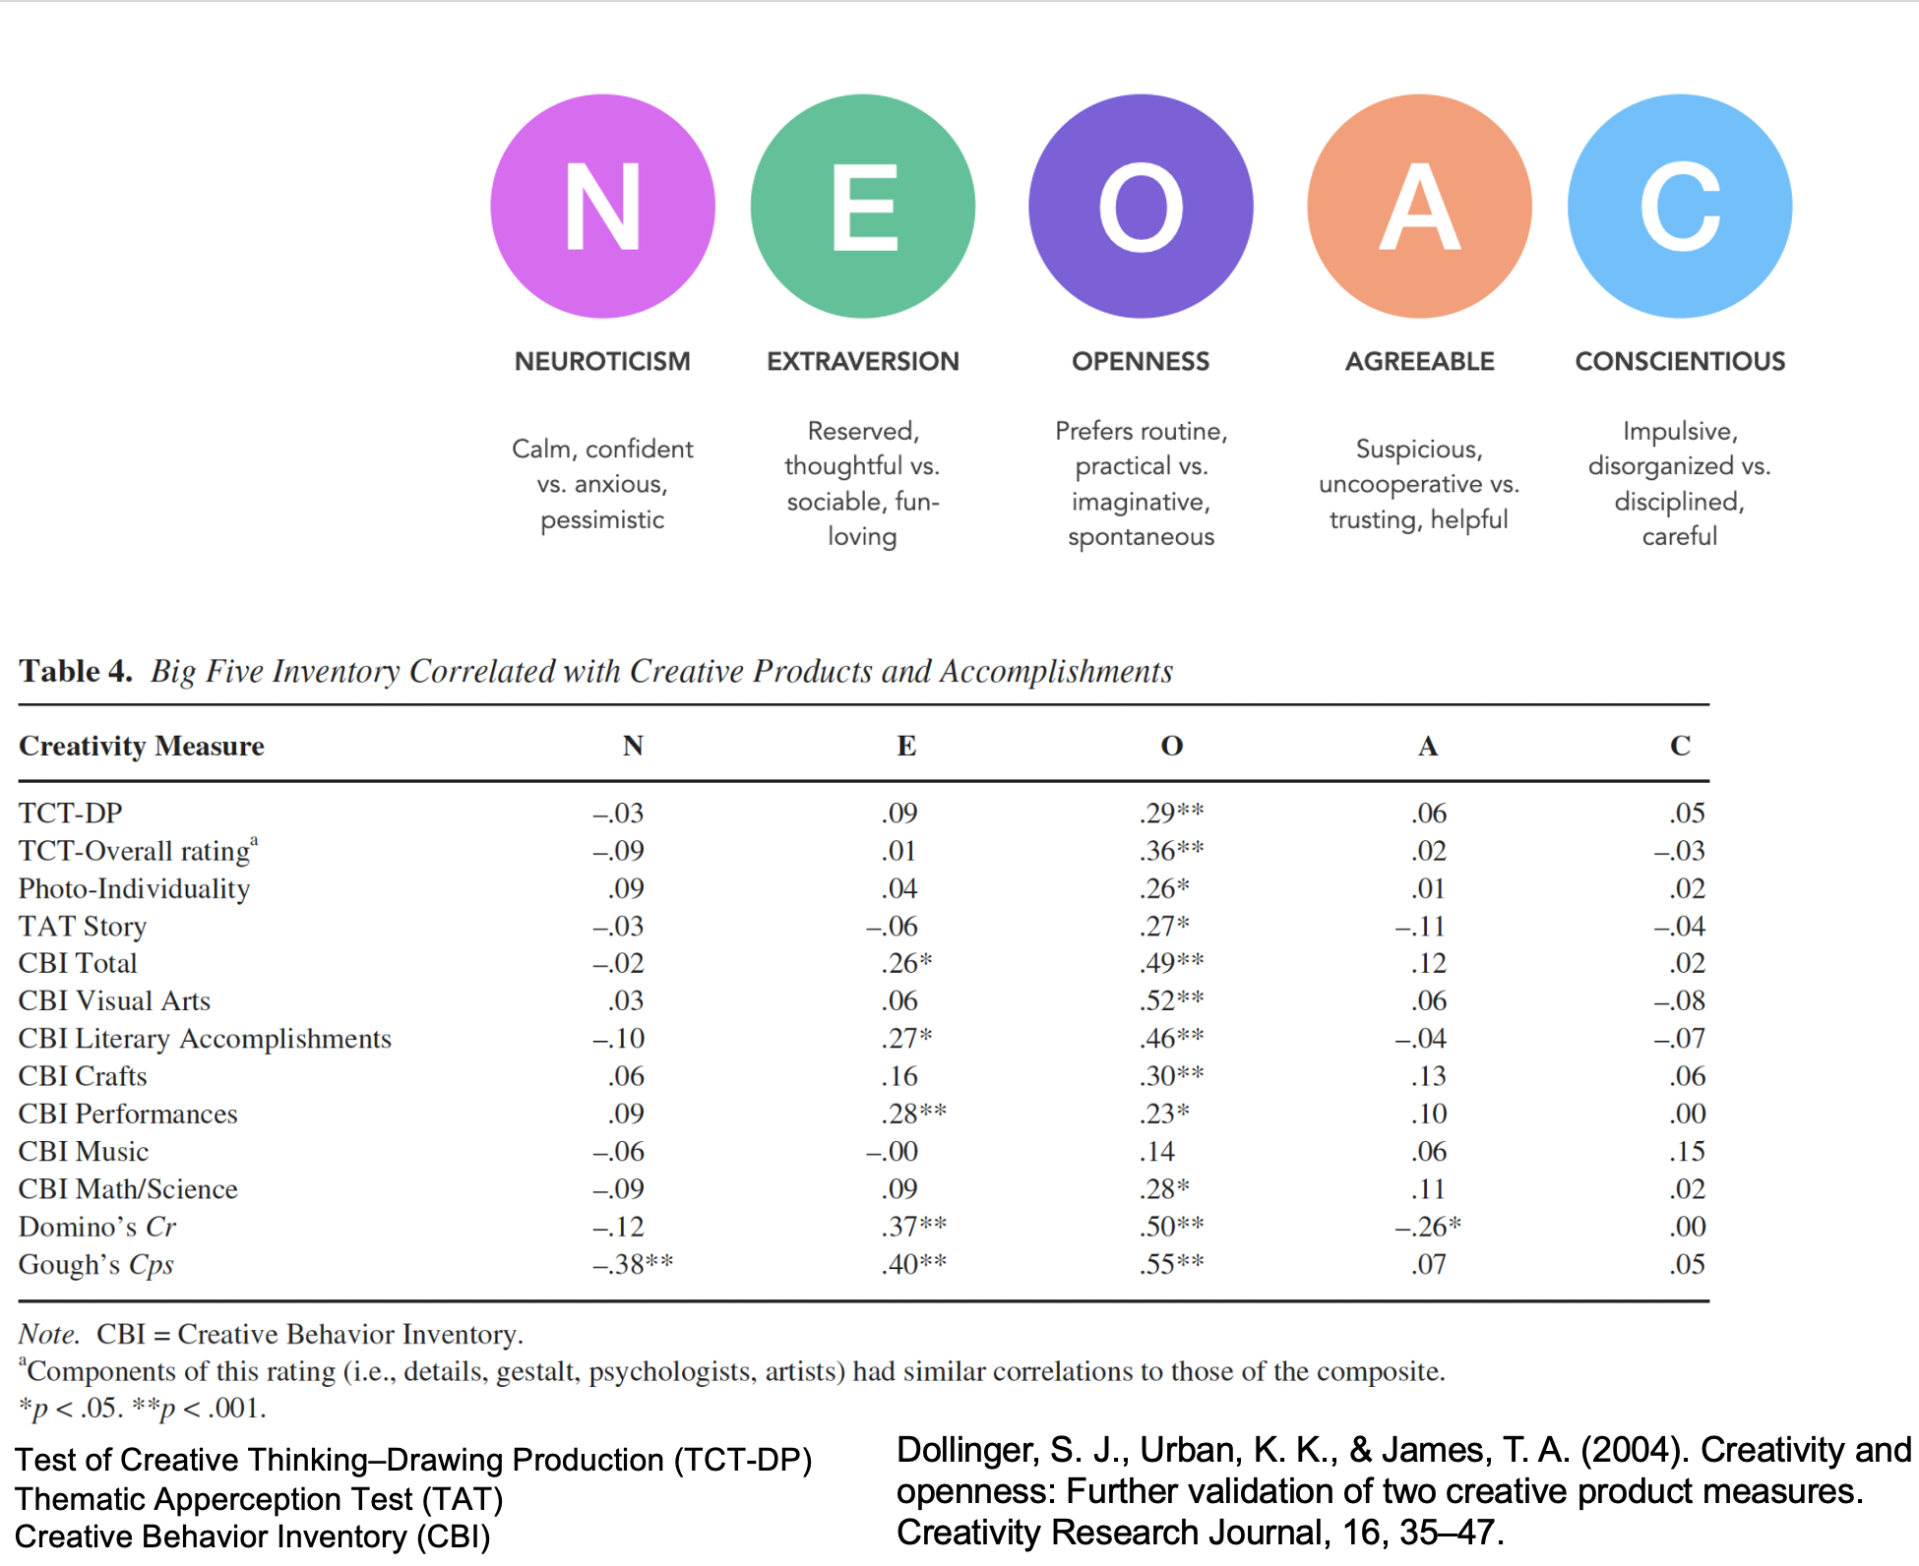
Psychologists quantify the ‘Big Five’ Personality Traits
Notes:
One of the most important skills in research is to navigate the evolution of a project – to come up with the ideas that allow us to proceed beyond every crisis.
Which personality traits might be helpful for this endeavour? Which types of people are more creative?
A common classification of personalities looks at five dimensions – the Big Five personality traits.
Would we expect, for example, that extroverted people are more creative than introverted ones? Or that impulsive and disorganized people are more creative than more conscientious ones?

Slide 45
How do they correlate with creativity measures?
Dollinger, S. J., Urban, K. K., & James, T. A. (2004). Creativity Research Journal, 16, 35–47.
Notes:
Psychologists have performed experiments to quantify the association of personality traits (the table columns) with different measures of creativity (the rows).
Maybe surprisingly, most personality traits show no consistent association with creativity – for creativity, it does not matter if you’re neurotic, extroverted, agreeable, or conscientious.

Slide 46
Only ‘Openness to experience’ correlates with creativity
Notes:
There is just one expception: the only personality trait that is consistently and significantly associated with creativity is “openness to experience”.
People who are more open tend to be more creative.
Luckily, openness is not only a personality trait – it is also an attitude.
If we want to become better scientists and we tend to be not very open naturally, we can consciously choose to be open in our projects.
For example, we can discuss our project with colleagues from diverse backgrounds, with the explicit goal of following some of the leads that they give us.

Slide 47
It takes two to think
Yanai & Lercher: It takes two to think. Nature Biotechnology
Yanai & Lercher: Improvisational science. Genome Biology
Notes:
We now start with the micro-view: the tools of the creative side of the scientific process.
This session describes the simplest and arguably most powerful tool for creativity: the creative discussion with someone else.
It’s not only important to talk – it is equally important how we talk.
The contents of this session are largely based on two publications by Itai & Martin:
https://dx.doi.org/10.1186/s13059-021-02575-w
https://www.nature.com/articles/s41587-023-02074-2

Slide 48
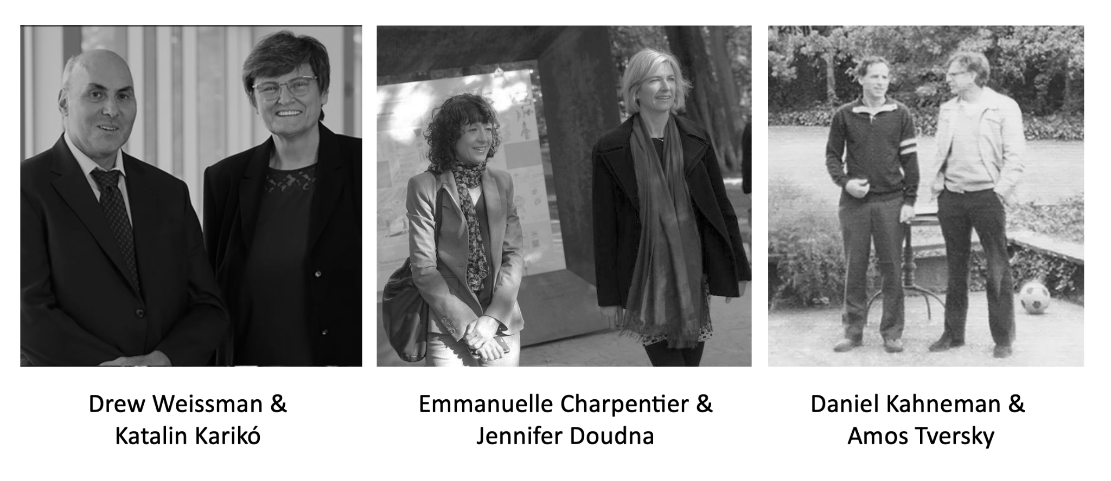
Taking a walk with a friend has always been a crucial part of the scientific method
Notes:
A crucial part of the scientific method has always been to take a walk with a friend.
Here are just some (semi-random) examples: Drew Weissman & Ktalin Karikó; Emmanuelle Charpentier & Jennifer Doudna; Daniel Kahneman & Amos Tversky
So what is it about these conversations that makes us creative?

Slide 49
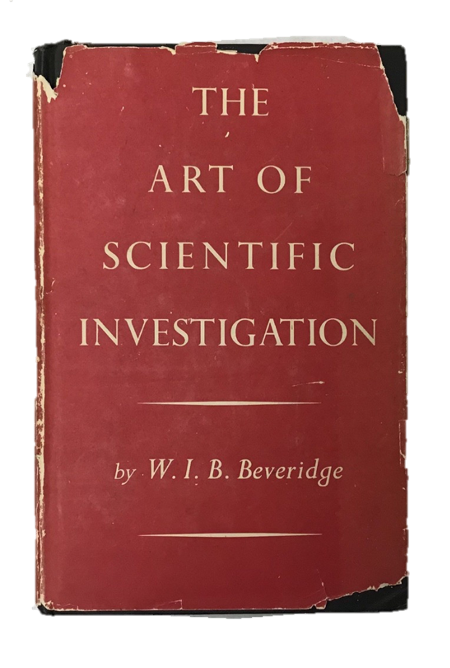
You need someone to talk to
Notes:
The advantages of talking with someone are already listed in this old book by Beveridge:
Talking your ideas out loud forces you to put the jumbled mess in your brain into a linear structure – to sort your thoughts and check their logic.
Together, you can pool your knowledge. For example, your colleague might recall an obscure paper with some relevant information that you never heard of; or she might see a connection to another phenomenon that you hadn’t thought of.
The other person can question your assumptions and the logic of your argument, forcing you to evaluate their reliability.
The other person can encourage you when you’re stuck in a crisis.
...

Slide 50

Traditional brainstorming is not ideal
Notes:
If talking to people helps your creativity, maybe talking to many people at once is even better?
So, you might think the solution is brainstorming, where many people try to be creative together – but traditional brainstorming is not ideal.
The same may be true for many lab meetings.
Why?
Which topics to follow gets decided in an ad-hoc way;
There is diffusion of responsibility: some people stay silent (“The others are already talking, so I don’t need to say anything”);
There is judgement of ideas;
Ideas do not get developed;
The strongest voices may decide the course of the discussion.

Slide 51
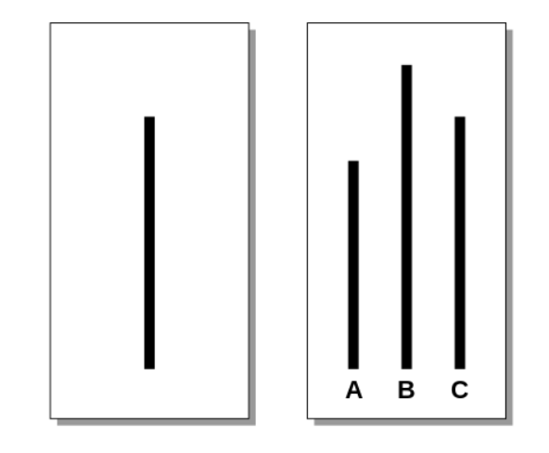
A particular problem with brainstorming is ‘group think’
Solomon Asch Experiment (1951)
Notes:
Another important reason why brainstorming doesn’t work is ‘group-think’.
The problem is conformity - adjusting our behavior or thinking to coincide with a group standard.
This was demonstrated in the Solomon Asch Experiment (1951):
The task is to say which one of A,B,C is most equal in length to the line on the left.
A subject is put in a group of people (for example, in this room).
If asked directly, 99% of participants correctly identify C (you can ask a particular person in the audience).
However, unbeknownst to the subject, the other people in the room are actors that are paid to give the same wrong answer, e.g., A.
If we first ask four of the actors, and they all say “A”, then the probability that the subject also wrongly says “A” becomes 50%.
We are different people when we are in a group!
Land: So a big group may not be the way to go for creative discussions

Slide 52
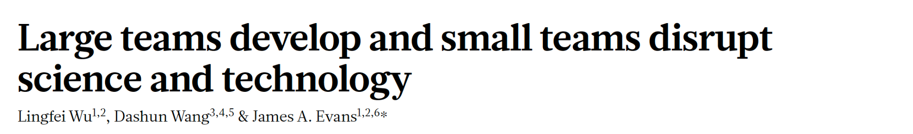
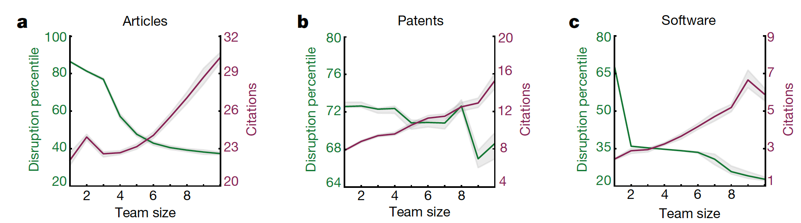
What is the ideal group size?
Nature, 2019
Notes:
So large groups may often not be ideal. What then is the ideal group size?
There is a fascinating paper about this from 2019.
The curves summarize data from citation networks of scientific papers from a given year.
The x-axis shows the number of authors.
The red curve shows how often the papers were cited (corresponding to the right y-axis).
Papers with more authors tend to get more citations: large teams are good at doing science that gets noticed.
But are large teams also creative?
To measure creativity, the study authors measured the extent to which later papers cited only a given paper, but not the older literature referenced in that paper.
If only this work – but not the older literture – is cited, this indicates that the work said something new – something creative, something disruptive.
This tendency is summarized by the green curve, the ‘disruption percentile’.
Papers published by the smallest teams are most disruptive – creativity drops with the number of authors.
The most creative teams were those of 2 people, and there’s a sharp drop for more than 3 people.

Slide 53

Discussions are best one-on-one
Your science buddy can:
encourage you
pool information
question reasoning errors
challenge your assumptions
keep you focused
Notes:
Thus, creativity appears to thrive when just two people are talking to each other.
Discussions are best one-on-one – it takes two to talk.
If we’re lucky, we find one or more science buddies: other researchers with whom we can have productive creative discussions, again and again.

Slide 54
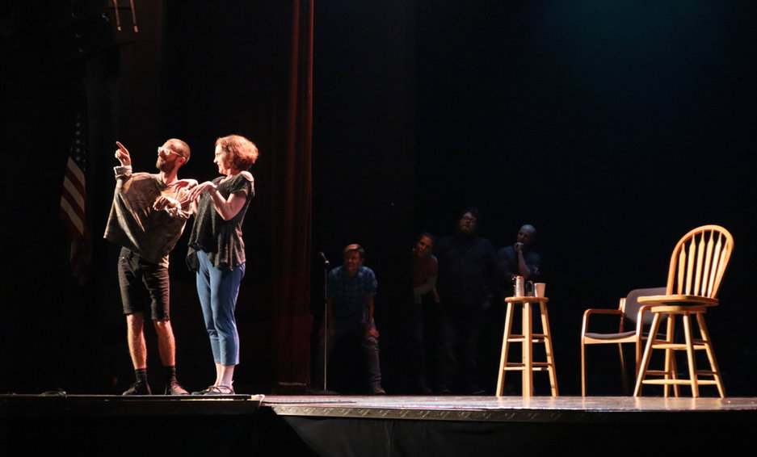
Creative discussions are improvisations
“Yes, and …”
Notes:
It’s not enough to talk. It’s equally important how we talk.
Here, we borrow from improvisational theatre, where actors perform without a script – they spontaneously come up with what happens.
A central rool of improvisational theatre is the “Yes, and…” rule.
It means that you must avoid blocking the other person. You don’t have to agree with everything the other person says – but you have to give their idea a chance to develop.
For example, if you say: “There’s a pink elephant in the corner of the room” and I say: “No, there’s nothing there”, the play will go nowhere. Instead, I could say: “Really? To me, it looks more like a big giraffe” and keep the idea developing.
It’s the same in science.
If my first reaction to your idea is: “No, that can’t be - there is a paper by Smith and Jones from 1973 that clearly disproved this idea”, then the idea is dead.
Instead, I could say: “Interesting idea. How do you think it fits with the results of Smith and Jones from 1973, who found x?”. This gives the idea a chance to develop.
Freshly born ideas are vulnerable, and they’re ugly. It’s easy to dismiss them, and it’s easy to kill them.
If we use the “Yes, and…” attitude, we’re good science buddies – we help ideas to grow instead of killing them.

Slide 55
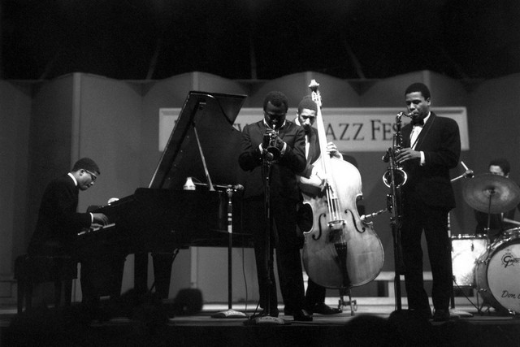
Make the other person feel comfortable
Notes:
Being creative makes us vulnerable. If someone shoots down our ideas, we may feel attacked as a person.
Judgement – by ourselves or by others – stiles creativity.
The “Yes, and…” attitude also helps to make people feel comfortable.
The picture shows the Miles Davis Quintett.
In one concert, Herbie Hancock on the piano (left) accidentally played a chord that was totally wrong – so wrong thast he spontaneously put his hands over his ears.
Miles Davis (center) briefly paused his solo, and then continued his melody in a way that made the wrong chord right.

Slide 56
Exercise: ‘What’s your worst idea?’
Pairs: We will get into pairs;
Spend two minutes getting to know each other
Improvise a project together: ‘What’s your worst idea for a project?’
    How would you extend/advance your project in a new direction?
    Something attractive to you, but may seem crazy/impossible
    Something you haven’t done yet, but might be interesting
Remember to use:
“Yes, and …” (avoiding “No” and “but”)
Make the other person feel comfortable
Swap roles and repeat.
Notes:
Each session has an exercise that allows participants to practice the tool that was introduced.
Here, it’s the “Yes, and…” attitude that is being practiced.
For this exercise, participants have to pair up, ideally with someone they don’t yet know (it’s a good idea to help the participants to sort themselves into pairs).
One partner starts by explaining their worst idea for a project.
It doesn’t really have to be their worst idea – it can secretely be their best idea.
Together with their partner, they try to develop the idea.
After a given time (here, 12 minutes), the partners switch roles, and it is now the other one’s task to tell their worst idea.
For all exercises, it is highly recommended that the instructor does a brief demonstration (e.g., with one of the participants) of how it could go.

Slide 57
Night Science Day Science
Process: | Open (evolution) | Closed (exp. design)
Mode: | Improvisational | Falsification
Compartmentalization: | Interdisciplinary | Disciplinary
Puzzle-state: | Puzzle-switching | Solution-testing
Goal: | Hypothesis-generating | Hypothesis-testing
Language: | Metaphorical | Precise
Logic: | Questions & Contradictions | Consistent Answers
Dimensionality: | Jump between planes | Stay on one plane
Notes:
In this session, we explored the conversational mode of the two subprocesses.
Night Science thrives on improvisational discussions.
Day Science aims to find the flaws in someones arguments.

Slide 58
You can do ‘it takes two to think’ with AI
Quantum physicist:
“All my good ideas come from talking with ChatGPT in voice mode.”
Ethan Mollick:
“But is ChatGPT good at quantum physics?”
Quantum physicist:
“No, but it asks the right questions.”
(Ethan Mollick on the Night Science Podcast)
Notes:
The Train-the-Trainer event at the New York Academy was partially sponsored by Research Theory (https://www.researchtheory.org)

Slide 59
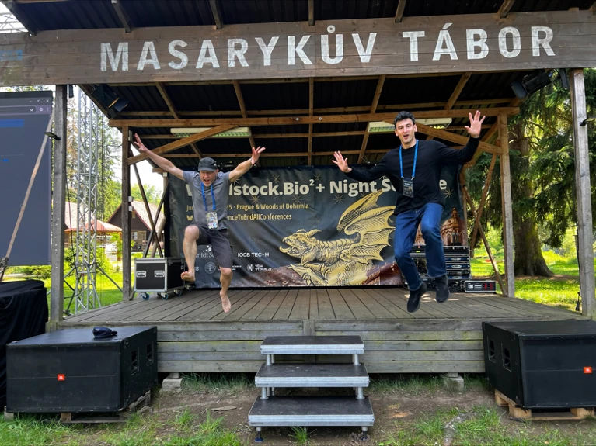

Workshop buddies

Slide 60
Part 2
The anatomy of a session
in a Night Science workshop
Notes:
This part of the Train-the-Trainer event goes through the teaching of one particular session, interwoven with meta-moments that explain the reasoning behind our teaching strategies.

Slide 61
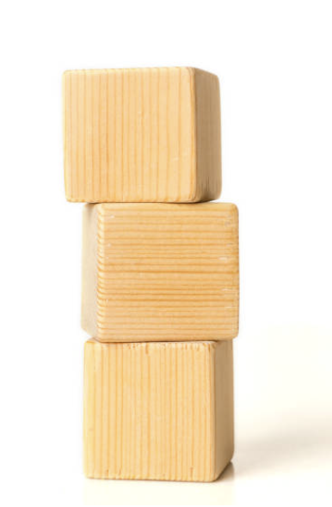
The anatomy of a Night Science workshop session
Lecture
  Story
  Teach
Tool
  Description
  Demonstration
  Exercise
  Debrief/Discussion

Slide 62
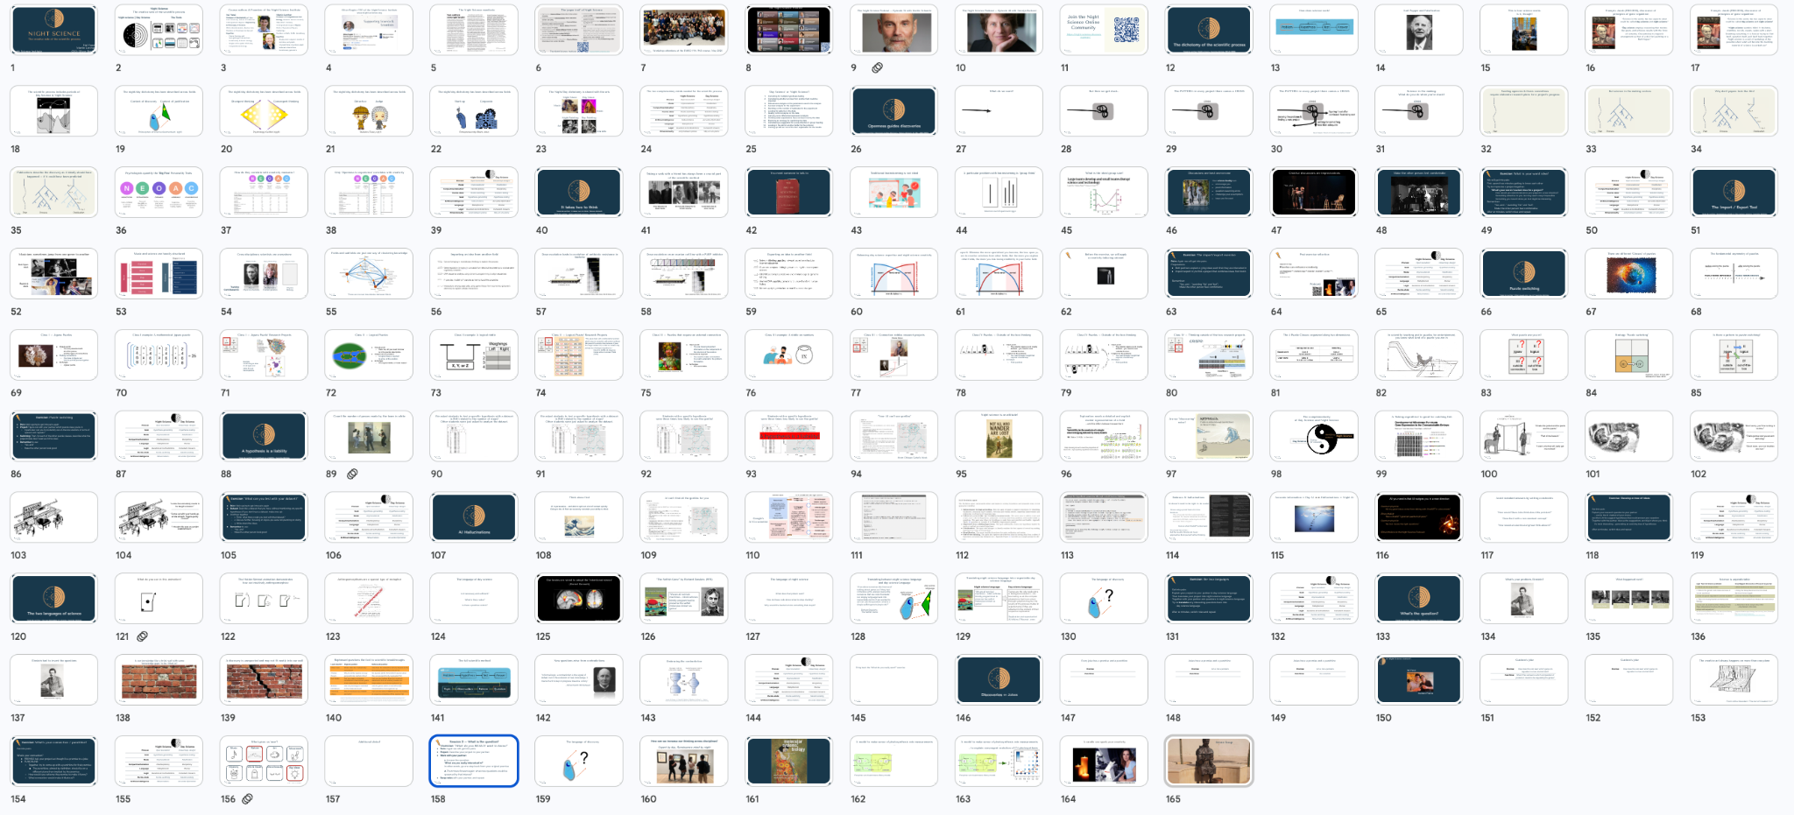
You will have the slides

Slide 63
The Import / Export Tool
Yanai & Lercher: Renaissance minds in 21st century science. Genome Biology 21:67 (2020)
Notes:
Another extremely important Night Science tool is the import and export of methods and concepts across the boundaries between fields and disciplines – this is the topic of this session.
The content of this session is largely from:
Yanai & Lercher, Renaissance minds in 21st century science. Genome Biology XXX
https://dx.doi.org/10.1186/s13059-020-01985-6

Slide 64
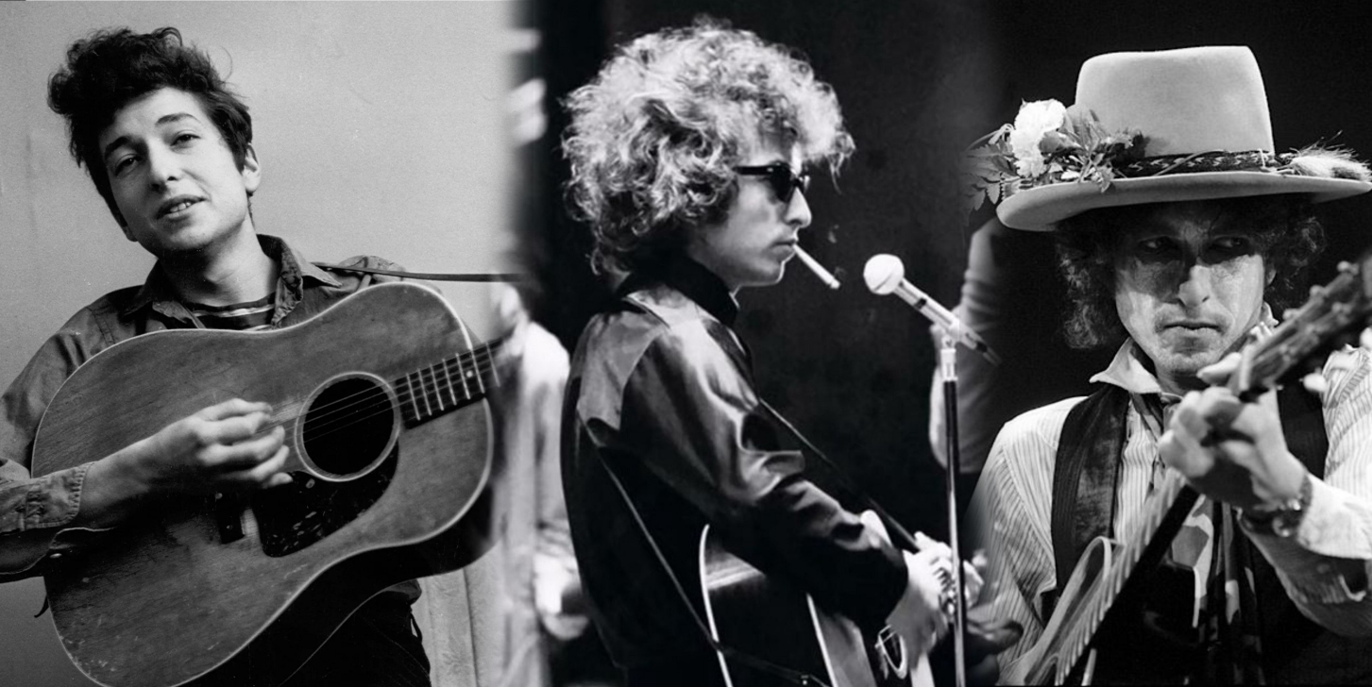
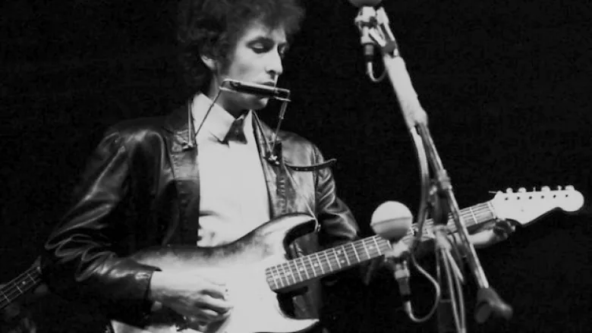
Musicians sometimes jump from one genre to another
Folk
Rock
Bob Dylan
1965
Notes:
Musicians sometimes jump from one genre to another.
One example is Bob Dylon.
By 1965, Bob Dylon was already highly successful in the folk scene – singing folk and protest songs accompanied by his acoustic guitar.
Then, he suddenly decided to switch genres: he started playing an electric guitar, accompanied by a rock band.
Many of his supporters didn’t like that change – they wanted only the old, folk-song Bob Dylan.
Beyoncé did something similar in 2024.
She was already a big star in R&B, pop, and hip-hop.
Then, in 2024, she put out a country album, Cowboy Carter.
This time, it weren’t her fans who disliked it. It was the country fans who saw her as an unwanted intruder.
Still, her album won the Grammy for the best country album of the year.
What both Bob Dylan understood was that while music has genres, musicians are not bound to one genre.
Bringing with them their experiences and artistry of folk and R&B, respectively, Bob Dylan and Beyoncé could do things in the new genres that would have been impossible for the people who always stayed in that genre.

Slide 65
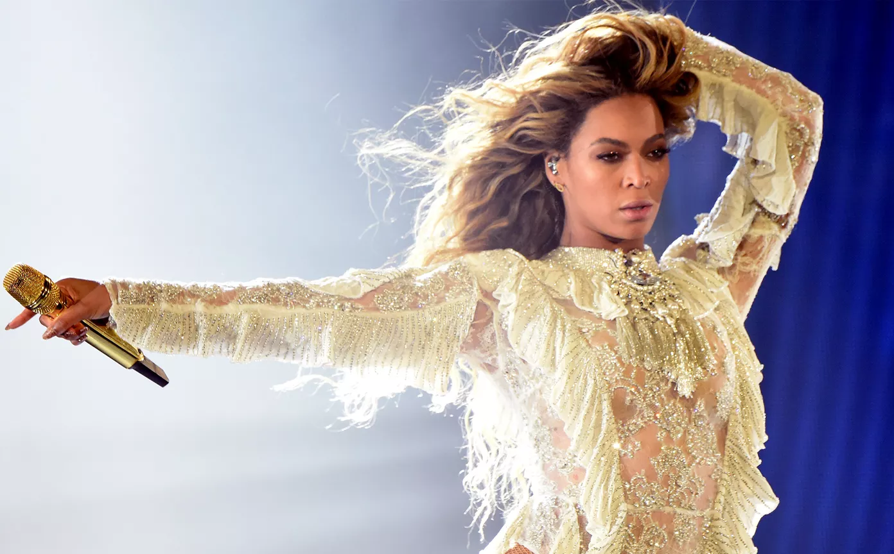

Musicians sometimes jump from one genre to another
Folk
Rock
Bob Dylan
1965
R&B, pop,
hip-hop
Best Country
Album
Beyoncé
2024
Notes:
Musicians sometimes jump from one genre to another.
One example is Bob Dylon.
By 1965, Bob Dylon was already highly successful in the folk scene – singing folk and protest songs accompanied by his acoustic guitar.
Then, he suddenly decided to switch genres: he started playing an electric guitar, accompanied by a rock band.
Many of his supporters didn’t like that change – they wanted only the old, folk-song Bob Dylan.
Beyoncé did something similar in 2024.
She was already a big star in R&B, pop, and hip-hop.
Then, in 2024, she put out a country album, Cowboy Carter.
This time, it weren’t her fans who disliked it. It was the country fans who saw her as an unwanted intruder.
Still, her album won the Grammy for the best country album of the year.
What both Bob Dylan understood was that while music has genres, musicians are not bound to one genre.
Bringing with them their experiences and artistry of folk and R&B, respectively, Bob Dylan and Beyoncé could do things in the new genres that would have been impossible for the people who always stayed in that genre.

Slide 66

Music and science are heavily structured
Classical
Rock
Music
Pop
Science
Rap
Country
Notes:
Similar to the division of music into genres and sub-genres, science is split into disciplines and fields.

Slide 67
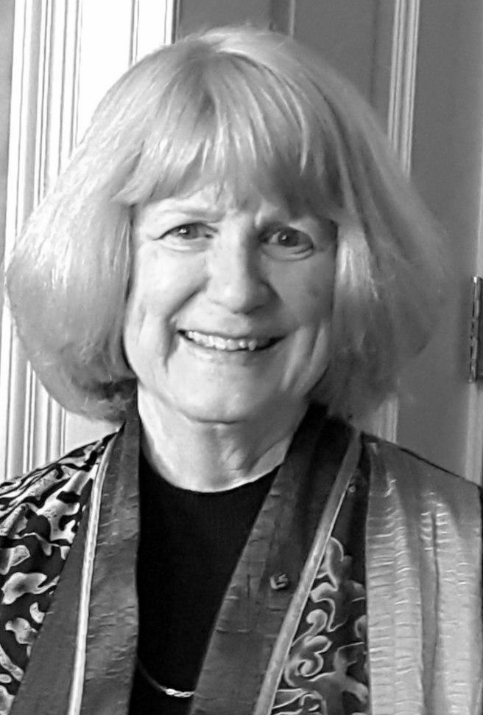
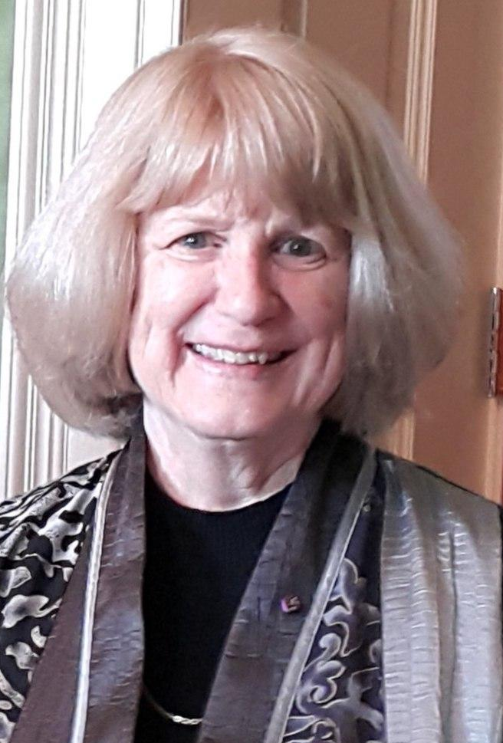
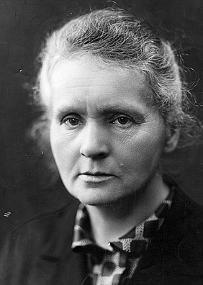
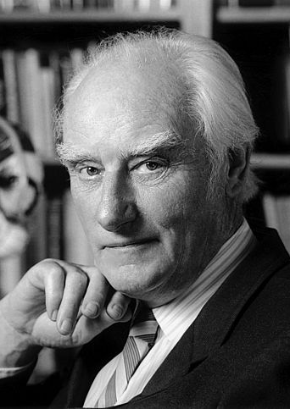
Cross-disciplinary scientists are everywhere
Marie Curie
Mary-Claire King
Francis Crick
Training:
Contributed to:
Physics
Physics & Chemistry
Mathematics
Human genetics
Physics
Biology
https://en.wikipedia.org/wiki/Mary-Claire_King CC BY-SA 4.0 <https://creativecommons.org/licenses/by-sa/4.0>, via Wikimedia Commons
Henri Manuel, Public domain, via Wikimedia Commons
Notes:
And just as musicians are not bound to one genre, scientists can move between fields:
Marie Curie was trained in physics and was awarded a Nobel prize in chemistry (in addition to one in physics).
Mary-Claire King was trained in mathematics and made major contributions to human genetics.
Francis Crick was trained in physics and made major contributions to biology.

Slide 68
A Train-the-Trainer Meta Moment
The Story / Teach / Tool concept
Telling an anecdote conveys the general idea.
Stories – to make concepts relatable
  Humor, cognitive relaxation and analogies provide the right setting for the tool.

Slide 69
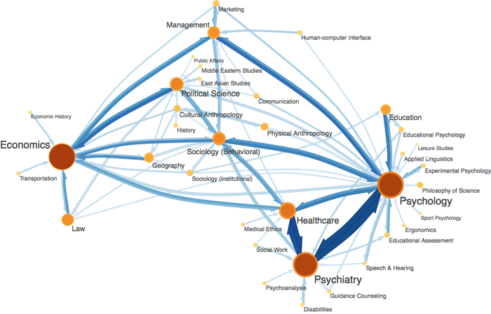
Fields and subfields are just one way of clustering knowledge
http://www.rationalskepticism.org/general-science/is-there-any-classification-of-academic-disciplines-t44278.html
There are no real boundaries between fields
Notes:
If you imagine the space of all possible knowledge as a continuous, multi-dimensional space, there are no natural boundaries that separate distinct fields.
The current separation of that space into disciplines and fields is historically grown.
There is no clear boundary between physics and chemistry, or chemistry and biochemistry, or psychology and psychiatry.

Slide 70
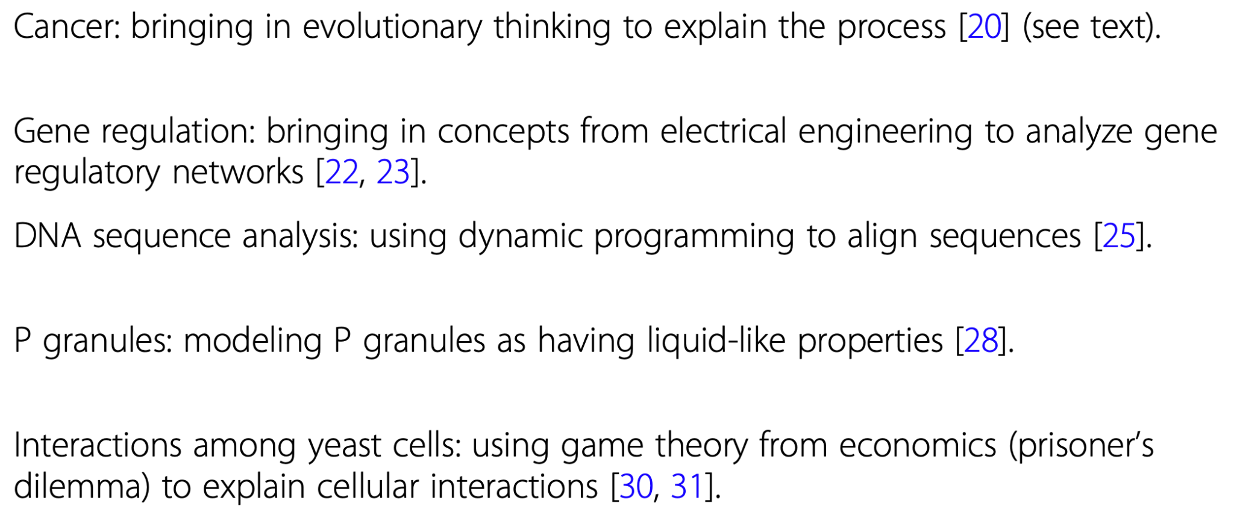
Importing an idea from another field
Notes:
Scientific progress often comes from importing an idea from another field.
For example, early cancer researchers did not view cancer as an evolutionary process. However, once that link had been made, many tools and concepts from evolutionary biology and population genetics were successfully applied to cancer biology.

Slide 71

Exporting an idea to another field
Notes:
Importing ideas from other fields into one’s own field is a rather common ingredient in scientific discoveries.
However, some scientists also export their ideas into other fields – they make contributions to fields different from where they originally came from.
This is similar to musicians like Bob Dylan and Beyoncé who publish music in genres different from their original ones.
For example, quantum computing is a branch of computer science, but was first developed by physicists.
When hearing the word meme, most people think of images or videos that summarize a simple idea and that spread through social media. However, the term ‘meme’ is actually much broader. It refers to the spread of cultural idas through human brains. was coined by Richard Dawkins in the last chapter of his amazing book ‘The selfish gene’, where he argues that cultural ideas (the memes) evolve in much the same way as the genes that are the topic of the rest of the book.

Slide 72
A Train-the-Trainer Meta Moment
The Story / Teach / Tool concept
Teach – what is the logic of the tool?
Provide:
  An overview over research on the tool
  Historical examples

Slide 73

Dose escalation leads to evolution of antibiotic resistance in bacteria
Notes:
This is an example from Itai’s research: his group imported an idea from microbiology to cancer research.
In the original microbiology study from Roy Kishony’s lab, researchers laced the agar on a giant plate with increasing concentrations of an antibiotic.
Link to paper: science.org/doi/10.1126/science.aad3292
The right panel shows seven images of the plate taken at different time points:
At time zero, the experimenters placed bacteria at the left end, where the antibiotic concentration was zero.
Bacteria then grew up to the boundary where the antibiotic started.
After a while, some bacteria adapted to the antibiotic and started to grow into the first antibiotic-containing region – but they again stopped growing at the boundary where the antibiotic concentration increased.
This pattern repeated at each boundary where the antibiotic increased: after a while, some bacteria adapted to the higher concentration in the next region and started to grow into it.
Through these step-wise adaptations, bacteria evolved to live in a concentration of antibiotic that was so high that no bacteria would survive if they were directly placed in that region.

Slide 74

Dose escalation on an ovarian cell line with a PARP inhibitor
Notes:
Itai’s team was inspired by this experiment to test if something similar occurs in the adaptation of cancer cells to an anti-cancer drug (top row).
They let cancer cells grow in a dish that contained increasing concentrations of the drug.
Link to paper: https://pubmed.ncbi.nlm.nih.gov/38987605/
Just as in the adaptation of bacteria to increasing antibiotic concentrations, the step-wise increase in drug concentrations allowed cancer cells to adapt to drug concentrations that would have been lethal to the first, unadapted cancer cells.
Thus, by importing an idea from microbiology, Itai’s team discovered how cancer cells adapt to high drug concentrations.

Slide 75
A Train-the-Trainer Meta Moment
The Story / Teach / Tool concept
Ideally, give an example where the tool was applied
from your own work – that makes it authentic and relatable
It can be a “small” application of the tool – it’s good to show that the tool works not only for Nobel laureates

Slide 76

Balancing day science expertise and night science creativity
Notes:
There are two extreme strategies scientists can pursue.
On the one hand, you can be an expert in one thing and know little about anything else.
Being such an expert is a great way to do science – many Nobel prizes went to experts that had worked on one specific system for decades.
However, being an expert also comes with a price: your ability to recognize things that could be imported or exported across fields will be limited.
On the other extreme, you can be a scientific nomad – someone who may not be a deep expert in any one field, but who knows a lot of thiings about a lot of topics.
Being a nomad is great for recognizing things to be imported or exported across fields.
However, not being an expert in any one thing is also limiting – not only because you might have difficulties being taken seriously by the experts

Slide 77
Expert's Dilemma: the more specialized you become, the less open you are to creative solutions from other fields. But the more you explore other fields, the more you risk losing credibility in your home field.
Notes:
We call this trade-off between Day Science expertise and Night Science creative potential “expert’s dilemma”.
The more specialized you become, the less open you are to creative solutions from other fields. But the more you explore other fields, the more you risk losing credibility in your home field.
As with most things in life, there is a middle ground that might best fit many people: still be somewhat of an expert in one thing, but also know a little about many other things.
We call this sweet spot the Renaissance region: many Renaissance thinkers were great at diverse things, such as Leonardo da Vinci – painter, scientist,

Slide 78

Before the exercise, we will apply a creativity-inducing odorant
Notes:
Before the exercise (could also be another exercise!), let’s do something fun.
We spray an aerosol into the room and tell participants that this is a substance that has been shown to increase people’s creativity.
The scientific background is explained after the exercise.

Slide 79
A Train-the-Trainer Meta Moment
Props are fun and memorable
There is an important lesson to be remembered here
– see the resolution!

Slide 80
Exercise: The import/export exercise
Pairs: Again we will get into pairs.
Ideas to be combined:
Both partners explain 2-3 big ideas each that they are interested in
Import/export:
Try to outline a project that combines ideas from both partners.
Remember to use:
  “Yes, and …” (avoiding “No” and “but”)
  Make the other person feel comfortable
Notes:
Each session has an exercise that allows participants to practice the tool that was introduced.
Here, it’s the import/export across fields that is being practiced in the context of the participants’ own projects.
For this exercise, participants again have to pair up, ideally with someone they don’t yet know (it’s a good idea to help the participants to sort themselves into pairs).
…
For all exercises, it is highly recommended that the instructor does a brief demonstration (e.g., with one of the participants) of how it could go.

Slide 81
A Train-the-Trainer Meta Moment
The Story / Teach / Tool concept
Tool – let the participants experience that it’s not just an abstract concept,
but actually actionable
Hands-on application in the context of their own project

Slide 82
A Train-the-Trainer Meta Moment
You really should do a demonstration before going into the exercise!
We never ask people to do something we wouldn’t do ourselves
The demonstrations
Give the participants an idea of what’s expected of them
Are spontaneous - not rehearsed
Take a risk - put yourselves out there.
Can be done with a volunteer from the audience, your workshop buddy,
or someone from your lab.

Slide 83
Exercise: The import/export exercise
Pairs: Again we will get into pairs.
Ideas to be combined:
Both partners explain 2-3 big ideas each that they are interested in
Import/export:
Try to outline a project that combines ideas from both partners.
Remember to use:
  “Yes, and …” (avoiding “No” and “but”)
  Make the other person feel comfortable
Notes:
Each session has an exercise that allows participants to practice the tool that was introduced.
Here, it’s the import/export across fields that is being practiced in the context of the participants’ own projects.
For this exercise, participants again have to pair up, ideally with someone they don’t yet know (it’s a good idea to help the participants to sort themselves into pairs).
…
For all exercises, it is highly recommended that the instructor does a brief demonstration (e.g., with one of the participants) of how it could go.

Slide 84

If you believe that you will be creative, then you will be creative
PLOS One, 2017
Notes:
First of all, let us reveal what you all heavily suspected: the odorant had no special, creativity-inducing ingredients
But it had a real chance to work, as demonstrated by this paper from Uri Alon’s group from 2017.

Slide 85



Use whatever helps to spark your creativity
Podcast
Magdalena Zernicka-Götz
Notes:
Magdalena Zernicka-Götz told us on the podcast that when she needs a creative insight, she likes to light a candle in her office.
Anything that can help to put you into a creative mood is great!

Slide 86
Post-exercise reflection
Notes:
Does anyone want to share their experience with the exercise?

Slide 87
A Train-the-Trainer Meta Moment
After each exercise, do a reflection with your audience
Participants can report on insights or struggles they had while doing the exercise

Slide 88
Night Science Day Science
Process: | Open (evolution) | Closed (exp. design)
Mode: | Improvisational | Falsification
Compartmentalization: | Interdisciplinary | Disciplinary
Puzzle-state: | Puzzle-switching | Solution-testing
Goal: | Hypothesis-generating | Hypothesis-testing
Language: | Metaphorical | Precise
Logic: | Questions & Contradictions | Consistent Answers
Dimensionality: | Jump between planes | Stay on one plane

Slide 89
A Train-the-Trainer Meta Moment
At the end of each session, we like to show how the new tool fits into the Day Science / Night Science dichotomy

Slide 90
Lunch

Slide 91









What gives us ‘awe’?
Music
Nature
Art
Movement
Mystery
Life & Death
Moral beauty
Big Ideas
Keltner & Haidt (2003)
Notes:
These are the different dimensions that can inspire awe in humans.
As scientists, we are deeply connected to two of them: “nature” and “big ideas”.

Slide 92
Part 3
7 additional thinking tools
covered in the Night Science Workshop
Notes:
This part summarizes the teaching of 7 other thinking tools for Night Science

Slide 93
Already Covered
The dichotomy of the scientific process
Yanai & Lercher: Night science. Genome Biology 20:179 (2019)
Notes:
We already covered this session in Part 1.

Slide 94
Already Covered
Openness guides discoveries
Yanai & Lercher: Openness guides discovery. Nature Biotech 43: 667–668 (2025)
Notes:
We already covered this session in Part 1.

Slide 95
Already Covered
It takes two to think
Yanai & Lercher: It takes two to think. Nature Biotech
Yanai & Lercher: Improvisational science. Genome Biology
Notes:
We already covered this session in Part 1.

Slide 96
Already Covered
The Import / Export Tool
Yanai & Lercher: Renaissance minds in 21st century science. Genome Biology 21:67 (2020)
Notes:
We already covered this session in Part 2.

Slide 97
There are also videos of us giving a workshop
You can use them to get an idea of how the individual sessions can be taught
You can also use them for an inverted classroom setting
There are videos of demonstrations by us for some of the exercises:
https://www.youtube.com/@Night_Science_Institute

Slide 98
The two languages of science
Yanai & Lercher: The two languages of science. Genome Biology 21:147 (2020)
Notes:
The content of this chapter is largely based on this publication:
https://dx.doi.org/10.1186/s13059-020-02057-5

Slide 99

What do you see in this animation?

Slide 100

The Heider-Simmel animation demonstrates how we intuitively anthropomorphize

Slide 101


Anthropomorphisms are a special type of metaphor

Slide 102
The language of day science
Is it necessary and sufficient?
What is the p-value?
Is there a positive control?

Slide 103

Our brains are wired to adopt the ‘intentional stance’
(Daniel Dennett)
Spunt et al. J Cogn Neurosci. (2015)

Slide 104
The language of night science
What does that protein want?
How do these cells know when to stop dividing?
Why would the bacterium do something that stupid?

Slide 105
Translating between night science language
and day science language
day science
language
“If we allow ourselves the license of talking about genes as if they had conscious aims, always reassuring ourselves that we could translate our sloppy language back into respectable terms if we wanted to, we can ask the question, what is a single selfish gene trying to do?”
Richard Dawkins,
The Selfish Gene
night science
language

Slide 106

Translating night science language into respectable day science language
Night science language:
Day science language:
“We are all survival machines – robot vehicles blindly programmed to preserve the selfish molecules known as genes”
“Genes are the sole replicators in biological evolution. [...] As fascinating as all the complex adaptations that have arisen through selection may be, the results of this process matter in selection only if they are reflected in the content of their respective replicators.”
‘Replication and reproduction’ JS Wilkins, P Bourrat - 2001

Slide 107
The language of discovery
?

Slide 108
Exercise: the two languages
Pairs: We will get into pairs
Project: Explain your project to your partner in Day Science language
Then translate it into Night Science language
Discuss: Together, ask questions in Night Science language
Translate any interesting questions back into Day Science language
Swap and repeat.
Notes:
Each session has an exercise that allows participants to practice the tool that was introduced.
Here, it’s the conscious use of the two languages that is being practiced.
Again, participants have to pair up, ideally with someone they don’t yet know (it’s a good idea to help the participants to sort themselves into pairs).
After a given time (here, 12 minutes), the partners switch roles.
For all exercises, it is highly recommended that the instructor does a brief demonstration (e.g., with one of the participants) of how it could go.

Slide 109
Night Science Day Science
Process: | Open (evolution) | Closed (exp. design)
Mode: | Improvisational | Falsification
Compartmentalization: | Interdisciplinary | Disciplinary
Puzzle-state: | Puzzle-switching | Solution-testing
Goal: | Hypothesis-generating | Hypothesis-testing
Language: | Metaphorical | Precise
Logic: | Questions & Contradictions | Consistent Answers
Dimensionality: | Jump between planes | Stay on one plane
Notes:
In this session, we explored the specific and very different languages of the two sub-processes.
Night Science permits any language – analogies and especially anthropomorphisms can help our intuition.
Day Science language has to be precise and should avoid analogies.

Slide 110
A hypothesis is a liability
Yanai & Lercher: A hypothesis is a liability. Genome Biology 21:231 (2020)
Notes:
The content of this session is largely based on this paper:
https://dx.doi.org/10.1186/s13059-020-02133-w

Slide 111

Count the number of passes made by the team in white
Notes:
The video shows selective attention: when we’re focused on one aspect, we might overlook other aspects that we would otherwise have seen.

Slide 112

We asked students to test a specific hypothesis with a dataset:
is BMI related to the number of steps?
Other students were just asked to analyze the dataset.
Notes:
We wondered if a similar process occurs when we analyze a dataset. Would the mental focus on a specific hypothesis prevent us from making a discovery?
To test this, we made up a dataset, pretending that it shows body mass index, BMI, vs. the numer of steps a person takes per day.
Group 1 of students was asked the following questions: (i) is there a statistically significant difference in steps taken by men and women, (ii) is there a negative correlation between number of steps and BMI for women, and (iii) is there a positive correlation for men. (iv) Is there anything else you can say about the dataset?
Group 2 was asked: what can you say about this dataset?

Slide 113
We asked students to test a specific hypothesis with a dataset:
is BMI related to the number of steps?
Other students were just asked to analyze the dataset.
Notes:
The most notable “discovery” : when plotting, you see a gorilla
often, the students driven by specific hypotheses skipped plotting

Slide 114
Students with a specific hypothesis
were three times less likely to see the gorilla!
Notes:
students without a specific hypothesis were about three times more likely to discover the gorilla

Slide 115
Students with a specific hypothesis
were three times less likely to see the gorilla!
A hypothesis is a liability!
Notes:
At least in this setting, the hypothesis indeed turned out to be a significant liability.

Slide 116

Night science is an attitude!
Notes:
Night science is an attitude!
It encourages us to explore and speculate. We ask: What could be hiding here? How would we lure it out?
We try look at the data from as many angles as possible.
In this mode, we take on a sort of playfulness with the data, comparing everything to everything else.
We become explorers, building a map of the data as we start out in one direction, switching directions at crossroads and stumbling into unanticipated regions.

Slide 117


Exploration needs a detailed and explicit mental representation of a field
– and this differs between researchers!
Notes:
When you roam the limits of the scientific knowns, you need a deep understanding of a field to even recognize a pattern or to recognize it as surprising.
Different backgrounds explain why different researchers discover different things in a dataset.
The same data can lead to different conclusions.
In one study, no two teams / 70 chose identical work flows to analyze the same dataset, and sets of teams reported contradictory, statistically significant effects.
Data is not transparent

Slide 118

Patternicity, or “just a correlation”?
Identifying patterns
Testing
for causality
Notes:
“Correlation is not causation”—an aphorism that perhaps all scientists have heard at least once in their careers—warns of putting too much weight on mere covariation of two variables. Undoubtedly, a correlation between two features is not sufficient to infer a causal relationship. But some form of covariation is implied by a causal relationship, and hence, finding a previously hidden correlation may be the first glimpse of something new. We may then think of data exploration as the generator of correlations and patterns that can later be tested for causality.
One of the major facilitators of human intelligence is our minds’ ability to easily find patterns and connections—a tendency called patternicity by Michael Shermer [8]. Patternicity helps us in generating new night science ideas; it is the seed of many discoveries. On the flipside, patternicity makes us vulnerable to being fooled by randomness [9], when we mistakenly infer relationships between genuinely independent things (called apophenia). Clearly, spurious results will be generated during unguided explorations, and this generation of false starts is night science’s own liability.
Day science tempers this liability. In a sense then, correlations are the domain of night science, while causation is solidified by day science. Day science is the adult in the room, rigorously testing hypotheses. But despite its power, the day science mode is not amenable to generating the ideas in the first place. Only the night science realm, with its lack of specific hypotheses that blind us in day science, allows us to think freely in an exploratory fashion. Science relies on this back and forth between day and night, each overcoming the other’s shortcomings; we can let ourselves explore so freely in night science because we trust ourselves to check the generated hypotheses later, in day science.

Slide 119


“I’ll take the jacket and the pants and the pants.”
_______________________
“Part of me loves it.”
_______________________
“I want a tie that will really get me noticed.”
Notes:
Let participants try the New Yorker cartoon contest, where readers suggest captions for a cartoon.
Do it both ways, so each individual feels the difference even on themselves: once when participants have read the top suggestions by readers, once without that.

Slide 120

Notes:
Do it both ways, so each individual feels the difference even on themselves
Split the group into two halves, one of which should close their eyes while you show the next slide, and re-open once the other participants have read the reader suggestions – and you have moved back to the version without the suggestions.
Then, all participants have 1-2 minutes to come up with their own original caption.

Slide 121
“Don’t worry, you'll be running in no time.”
_______________________
“That’s gonna cost you an arm and a leg.”
_______________________
“Good news, your car troubles are over.”

Slide 122

Notes:
Now the two groups swap roles: the other group closes their eyes while you show the reader suggestions.

Slide 123
“Looks like somebody needs to be taught a lesson.”
_______________________
“Come out with your hands up, wrists straight, fingers gently curved!”
_______________________
“I thought this was an upright establishment.”

Slide 124
Exercise: ‘What can you test with your dataset?’
Pairs: We’re going to get into pairs again
Dataset: Describe a dataset that you have, without mentioning any specific hypotheses (if you don’t have a dataset, make one up).
Discuss: together,
1. Think: what more could you test with that dataset?
2. Discuss further, focusing on topics you were not planning on doing.
Remember to use:
“Yes, and”
Make the other person feel comfortable
Swap roles and repeat
Notes:
Each session has an exercise that allows participants to practice the tool that was introduced.
Here, it’s the hypothesis-free exploration that is being practiced.
Again, participants have to pair up, ideally with someone they don’t yet know (it’s a good idea to help the participants to sort themselves into pairs).
After a given time (here, 12 minutes), the partners switch roles.
For all exercises, it is highly recommended that the instructor does a brief demonstration (e.g., with one of the participants) of how it could go.

Slide 125
Night Science Day Science
Process: | Open (evolution) | Closed (exp. design)
Mode: | Improvisational | Falsification
Compartmentalization: | Interdisciplinary | Disciplinary
Puzzle-state: | Puzzle-switching | Solution-testing
Goal: | Hypothesis-generating | Hypothesis-testing
Language: | Metaphorical | Precise
Logic: | Questions & Contradictions | Consistent Answers
Dimensionality: | Jump between planes | Stay on one plane
Notes:
In this session, we explored the specific and very different languages of the two sub-processes.
Night Science permits any language – analogies and especially anthropomorphisms can help our intuition.
Day Science language has to be precise and should avoid analogies.

Slide 126
What’s the question?
Yanai & Lercher: What is the question? Genome Biology 20:289 (2019)
Notes:
The content of this session is largely based on this publication:
https://dx.doi.org/10.1186/s13059-019-1902-1

Slide 127

What’s your problem, Einstein?
Albert Einstein, age 23

Slide 128
Science is unpredictable
1997: Top Life Science problems | 2015: Biggest discoveries of the past 25 year [5]
1. What was the origin of life? | 1. RNA Interference Discovered (1998)
2. What is the genetic and molecular basis of neural specificity? | 2. Dolly the Sheep Becomes the First Adult Mammal Cloned (1996)
3. How are genes regulated in animals & plants? | 3. Human Genome Mapped (2000)
4. Topics in developmental and behavioral biology. | 4. Stem Cells Created from Mature Skin Cells (2007)
5. How can we predict protein folding and the three-dimensional structure of proteins from amino acid sequences? | 5. AlphaFold 2 from Google Deep Mind – 2024 Nobel in Chemistry
Dev SB. Unsolved problems in biology - The state of current thinking. Prog. Biophys. Mol. Biol. Elsevier Ltd; 2015. p. 232–9. | 5 Important Breakthroughs in Biology from the Last 25 Years | Brainscape Blog. https://www.brainscape.com/ blog/2015/06/biology-breakthroughs-and-discoveries/

Slide 129
Einstein had to invent the questions
Albert Einstein, age 23

Slide 130

Is our knowledge like a brick wall with some
‘knowledge gaps’ to be filled in?

Slide 131

A discovery is unexpected and may not fit neatly into our wall
Notes:
This is because this picture gives a false sense of the structure and rigidity of knowledge and its accumulation.
Discoveries are by nature unexpected
They may not fit neatly into our existing edifice of knowledge
There may be a perceived gap - but the solution maybe doesn’t fill it, it may restructure the complete wall
the most interesting unknowns of science are unknown unknowns—gaps that we were not even aware of before chancing upon them.
Young scientists are only slowly immersed in this confusing complexity
A student joining a lab is often presented with a hypothesis or a clear question to work on
Only as a postdoc they realize that a crucial part of their job is to discover questions

Slide 132
Rephrased questions that led to scientific breakthroughs
Lead scientist | Original question | Refocused question
Marie Curie | Where does the “radioactivity” come from? | How does the radioactive activity depend on the form and quantity of the uranium? [1]
Charles Darwin | Why do similar species occupy geographically related niches? | Do species split to form distinct species when they are geographically segregated? [2]
Kurt Gödel | Can you make a complete, contradiction-free formal system of all mathematical theorems? | Can you use number theory to construct statements that are neither provable nor disprovable in such formal systems? [3]
Barbara McClintock | How are phenotypes controlled on the molecular level? | How do genes switch on and off certain characteristics of an organism? [4]
Francisco Mojica | Why do bacteria have CRISPR elements? | Can we learn about CRISPR function by looking at sequence similarities of the spacers? [5]
[1] Curie MS. Rays emitted by compounds of uranium and of thorium. Comptes Rendus. 1898;126:1101–3.; [2] Darwin C. On the Origin of Species by Means of Natural Selection, Or, The Preservation of Favoured Races in the Struggle for Life. J. Murray; 1859.; [3] Über formal unentscheidbare Sätze der Principia Mathematica und verwandter Systeme I. Monatshefte für Math. und Phys. Springer-Verlag; 1931;38:173–98.; [4] McClintock B. The origin and behavior of mutable loci in maize. Proc. Natl. Acad. Sci. U. S. A. 1950;36:344–55.; [5] Mojica FJM, Díez-Villaseñor C, Soria E, Juez G. Biological significance of a family of regularly spaced repeats in the genomes of Archaea, Bacteria and mitochondria. Mol. Microbiol. 2000. p. 244–6.

Slide 133
The full scientific method

Slide 134
Exercise: What do you really want?
Pairs: We’re going to get into pairs again.
Project: Describe your project to your partner.
Questions: With the help of your partner, answer the questions:
What fascinates you about this project?
What are you really interested in?
What new questions could be spawned by that interest?
Remember to use:
“Yes, and”
Make the other person feel comfortable
Swap roles and repeat.
Notes:
Each session has an exercise that allows participants to practice the tool that was introduced.
Here, it’s the finding of new questions that is being practiced.
Again, participants have to pair up, ideally with someone they don’t yet know (it’s a good idea to help the participants to sort themselves into pairs).
After a given time (here, 12 minutes), the partners switch roles.
For all exercises, it is highly recommended that the instructor does a brief demonstration (e.g., with one of the participants) of how it could go.

Slide 135
Night Science Day Science
Process: | Open (evolution) | Closed (exp. design)
Mode: | Improvisational | Falsification
Compartmentalization: | Interdisciplinary | Disciplinary
Puzzle-state: | Puzzle-switching | Solution-testing
Goal: | Hypothesis-generating | Hypothesis-testing
Language: | Metaphorical | Precise
Logic: | Questions & Contradictions | Consistent Answers
Dimensionality: | Jump between planes | Stay on one plane
Notes:
In this session, we explored the specific and very different languages of the two sub-processes.
Night Science permits any language – analogies and especially anthropomorphisms can help our intuition.
Day Science language has to be precise and should avoid analogies.

Slide 136
Embracing the Contradiction
Yanai & Lercher: Novel predictions arise from contradictions. Genome Biology 22:153 (2021)
Notes:
Link to paper: https://link.springer.com/article/10.1186/s13059-021-02371-6

Slide 137
What relationship do you expect between wealth and happiness?
Notes:
We also propose that embracing the night science attitude improves how we do science. To see this we want to tell you about an experiment we did.
We posit that night science’s exploratory mode counteracts such cognitive biases, opening the door to new insights and predictions that can profoundly alter the course of a project.
Many scientists and the public at large are concerned about a “reproducibility crisis” in science: the observation that many published results cannot be replicated [27]. While it may be tempting to lay the fault at the door of a select group of misbehaving individuals, the wide scope of the observed non-reproducibility suggests that it may be a pernicious aspect of the scientific process itself [27].
To study how our biases influence data interpretation, we performed an experiment with university students of computer science [2]. We showed them the plot in Fig. 1a, claiming that the data was collected to study the relationship between the personal wealth of individuals (x-axis) and their life satisfaction (“happiness,” y-axis). The data points indicating individuals were colored according to age groups. We then asked each participant: “Does the data suggest that wealth leads to happiness?”
The plot shows an overall negative correlation between wealth and happiness (Fig. 1b), while within each age group, a positive correlation is evident (Fig. 1c). This is an example of Simpson’s paradox [3, 4], where the correlation between two variables changes sign after controlling for another variable. The most parsimonious explanation of the pattern in the plot is that, all else being equal, more money makes you happier (thus the positive within-age group correlation). Across age groups, this effect is drowned out by a second, stronger effect from an underlying negative relationship between age and happiness. [We note that since this data was artificially created, no conclusions on real-life connections should be drawn.] In sum, while a first glimpse may indicate that wealthier individuals are less happy, the data indeed suggests that wealth leads to happiness. About a third of our participants acknowledged this by answering “yes” (49/171).

Slide 138

Does the data suggest that wealth leads to happiness?
Notes:
To study how our biases influence data interpretation, we performed an experiment with university students of computer science [2].
We showed them the plot claiming that the data was collected to study the relationship between the personal wealth of individuals (x-axis) and their life satisfaction (“happiness,” y-axis). The data points indicating individuals were colored according to age groups. We then asked each participant: “Does the data suggest that wealth leads to happiness?”
The plot shows an overall negative correlation between wealth and happiness (Fig. 1b), while within each age group, a positive correlation is evident (Fig. 1c). This is an example of Simpson’s paradox [3, 4], where the correlation between two variables changes sign after controlling for another variable.
The most parsimonious explanation of the pattern in the plot is that, all else being equal, more money makes you happier (thus the positive within-age group correlation). Across age groups, this effect is drowned out by a second, stronger effect from an underlying negative relationship between age and happiness.
[We note that since this data was artificially created, no conclusions on real-life connections should be drawn.]
In sum, while a first glimpse may indicate that wealthier individuals are less happy, the data indeed suggests that wealth leads to happiness. About a third of our participants acknowledged this by answering “yes” (49/171).

Slide 139
This is a case of Simpson’s Paradox
Notes:
Regardless of what conclusion a particular participant made, we would like to assume that it arose from an analysis of the data plot, rather than resulting from preconceived notions.
To test if this was indeed the case, we had inquired into the participants’ biases before showing them the data plot, asking the following question: “Imagine collecting data to study the relationship between the personal wealth of individuals and their life satisfaction (“happiness”). What overall general correlation do you expect?”
Seventy percent of the students (119/171) expected a positive correlation, while the remaining students expected a negative one.
Strikingly, the two groups saw the same data differently: those with an expectation of a positive correlation were more than twice as likely to conclude a positive correlation than those expecting a negative correlation (Table 1; 42/119 vs. 7/52, odds ratio 3.48, P = 0.0024 from one-sided Fisher’s exact test) [2].

Slide 140

Confirmation bias

Slide 141
Data is not transparent

Slide 142
On contradictions
“In formal logic, a contradiction is the signal of defeat, but in the evolution of real knowledge, it marks the first step in progress toward a victory.”
Alfred North Whitehead

Slide 143

Embracing the contradiction
Levin, Anavy et al. Yanai. (2016)

Slide 144
Exercise: Embracing the contradiction
Pairs: We will get into pairs.
Project: Try to emphasize the very thing that doesn’t make sense.
First individually: think of what’s troubling you in your project.
What’s the result that you wish was different?
Now together: Explain the project you are currently working on.
Instead of “sweeping under the rug” an anomaly, embrace it.
Work with your partner on what it might mean?
Remember to use:
“Yes, and” (avoiding “No, but”)
Make the other person feel comfortable
Swap roles and repeat.
Notes:
Each session has an exercise that allows participants to practice the tool that was introduced.
Here, it’s the embracing of contradictions that is being practiced.
Again, participants have to pair up, ideally with someone they don’t yet know (it’s a good idea to help the participants to sort themselves into pairs).
After a given time (here, 12 minutes), the partners switch roles.
For all exercises, it is highly recommended that the instructor does a brief demonstration (e.g., with one of the participants) of how it could go.

Slide 145
Night Science Day Science
Process: | Open (evolution) | Closed (exp. design)
Mode: | Improvisational | Falsification
Compartmentalization: | Interdisciplinary | Disciplinary
Puzzle-state: | Puzzle-switching | Solution-testing
Goal: | Hypothesis-generating | Hypothesis-testing
Language: | Metaphorical | Precise
Logic: | Questions & Contradictions | Consistent Answers
Dimensionality: | Jump between planes | Stay on one plane
Notes:
In this session, we explored the specific and very different languages of the two sub-processes.
Night Science permits any language – analogies and especially anthropomorphisms can help our intuition.
Day Science language has to be precise and should avoid analogies.

Slide 146

What gives us ‘ugh’?
Grant rejection
Keltner & Haidt (2003)
Notes:
These are the different dimensions that can inspire awe in humans.
As scientists, we are deeply connected to two of them: “nature” and “big ideas”.

Slide 147
Sympathy for Night Science
Please allow me to introduce myself
Well I’m a creative state of mind
I've been around for a long, long year
And I’ve helped many of your kind
And I was 'round when Darwin
Had his natural selection insight
Made damn sure that Marie Curie’s mind
Flew high as a radioactive kite
Pleased to meet you, hope you guess my name
They call me night science, discovery is my game
I come around when you are stuck
And you are desperate for a change
Import ideas from plant biology
That puzzle state must rearrange
My favorite words are yes and and
With my buddy I improvise – forgive me not
You now know that it’s not true
That Popper is all we’ve got
Pleased to meet you, hope you guess my name
They call me night science, discovery is my game

Slide 148
Puzzle switching
Yanai & Lercher: What puzzle are you in? Genome Biology 23:179 (2022)
Notes:
The material for this section is found in this piece:
https://link.springer.com/article/10.1186/s13059-022-02748-1

Slide 149

There are different ‘Classes’ of puzzles
Notes:
Despite their complexity, nature’s puzzles can be classified in the same way as puzzles humans invented for entertainment:
There are the jigsaw puzzles, logical puzzles, puzzles where we need to find connections to phenomena outside the problem description, and puzzles that require us to think outside the box, often by identifying and dropping implicit assumptions.
These archetypes can be distinguished along two dimensions: whether they are closed-world or open-world; and whether the major insights come from making connections or from deeper insights into the problem structure.
We propose that four kinds of puzzles can be described
They lie on two axes: open/closed-world | making connections vs. trick (requirement for a mental leap)
In “puzzle” settings, we know which type we’re in
But in science, we have no way to be sure which type we’re in - that’s one of the reasons that open research puzzles are so hard to answer

Slide 150

The four Puzzle Classes organized along two dimensions
Notes:
These four puzzle archetypes can be arranged on a two-dimensional grid.
The first dimension concerns the completeness of the problem formulation: closed-world (Classes I and II) versus open-world (Classes III and IV).
The second dimension concerns the type of insight required: finding connections (Classes I and III) versus the need to reframe the problem – either through an insight into the problem structure (Class II) or by moving our thinking out of the box (Class IV).
If you know where you are on this grid, you know which type of puzzle you are in.

Slide 151



‘Class I – Jigsaw Puzzle’ Research Projects
Example: constructing an atlas of cell types and states through transcriptomics.
Notes:
Jump:
…
Land:
Looking at specific scientific discoveries, we can see that many fit neatly into one of the four classes of puzzles.
Anything that requires following an established protocol – such as obtaining the 3-D structure of a protein, assembling a complete genome, or defining the embryonic cell lineage of an organism – is a Class I puzzle.
The scientists involved know that there is a solution, and they know what ingredients it has.
The ingredients “just” have to be put together in the right way.
Consider the production of an atlas of cell types and states using transcriptomics (single-cell and spatial).
For a given organ or an entire organism, numerical representations of the cells (or pieces) can be assembled to reconstruct the system [2]. Technical obstacles must be overcome and new aspects may be discovered, but they are confined to the world established by the parts.

Slide 152
The four Puzzle Classes organized along two dimensions
Notes:
These four puzzle archetypes can be arranged on a two-dimensional grid.
The first dimension concerns the completeness of the problem formulation: closed-world (Classes I and II) versus open-world (Classes III and IV).
The second dimension concerns the type of insight required: finding connections (Classes I and III) versus the need to reframe the problem – either through an insight into the problem structure (Class II) or by moving our thinking out of the box (Class IV).
If you know where you are on this grid, you know which type of puzzle you are in.

Slide 153

‘Class II – Logical Puzzle’ Research Projects
“This paper deals with a mathematical problem which arose in connection with protein synthesis. We present the solution here because it gives the ‘magic number’ 20, so that our answer may perhaps be of biological significance.”
Crick FH, Griffith JS, Orgel LE. Codes without commas. PNAS (1957)
Notes:
Jump:
…
Land:
As an example for a closed-world, logical Class II puzzle, consider how Francis Crick and colleagues, in the years that followed the discovery of the double helix, thought about what the structure of the genetic code might be.
Working with the constraints that the twenty naturally occurring amino acids must be encoded by only four nucleotides, they had the insight that the coding might operate in a ‘comma-free’ fashion:
“This paper deals with a mathematical problem which arose in connection with protein synthesis. We present the solution here because it gives the ‘magic number’ 20, so that our answer may perhaps be of biological significance.”
Studying the problem as a logical puzzle, Crick and colleagues noticed that the set of 64 triplets (today’s ‘codons’) collapses to precisely 20 if the constraint is added that it should be immediately clear in which frame the code is to be read.
Thus, the four same-letter codons (‘AAA’, ‘CCC’, ‘GGG’, and ‘TTT’) are eliminated, as using these would lead to unclear frame encoding in the case of repeats.
The remaining 60 triplets fall into twenty groups, each containing three ‘triplets’ that are cyclic permutations of each other, such as ‘ACG’, ‘CGA’, and ‘GAC’.
If only one triplet from each set is used and the rest is avoided, there would be 20 usable triplets – the precise number of amino acids. This is a great use of logic – although, of course, it didn’t end up being the correct solution.
But one very good idea came from it: they predicted the existence of an adaptor molecule, which was later discovered to be transfer RNA.

Slide 154
The four Puzzle Classes organized along two dimensions
Notes:
These four puzzle archetypes can be arranged on a two-dimensional grid.
The first dimension concerns the completeness of the problem formulation: closed-world (Classes I and II) versus open-world (Classes III and IV).
The second dimension concerns the type of insight required: finding connections (Classes I and III) versus the need to reframe the problem – either through an insight into the problem structure (Class II) or by moving our thinking out of the box (Class IV).
If you know where you are on this grid, you know which type of puzzle you are in.

Slide 155


‘Class III – Connection Riddles’ Research Projects
Charles Darwin
connection
Thomas Malthus
Notes:
Jump:
…
Land:
Much of scientific progress comes from making connections, thus constituting Class III puzzles.
For example, following others, Kurt Gödel examined the notion of making a complete, contradiction-free formal system of all mathematical theorems. He found that by connecting this question to number theory, one could show the existence of statements that are neither provable nor disprovable in such formal systems, thereby demonstrating that the then-popular search for a unified and complete mathematical system was futile.
In a second example, Darwin famously connected the local adaptations he saw on his world trip on the Beagle with the work of economist Malthus. Malthus had pessimistically stated that since unchecked population growth would be exponential, war and disease must be a constant aspect of the human condition. Darwin realized that in this situation, the better adapted individuals have a better chance of leaving offspring. He termed the corresponding process natural selection and proposed that it explains how adaptation in biological populations occurs over eons.

Slide 156
The four Puzzle Classes organized along two dimensions
Notes:
These four puzzle archetypes can be arranged on a two-dimensional grid.
The first dimension concerns the completeness of the problem formulation: closed-world (Classes I and II) versus open-world (Classes III and IV).
The second dimension concerns the type of insight required: finding connections (Classes I and III) versus the need to reframe the problem – either through an insight into the problem structure (Class II) or by moving our thinking out of the box (Class IV).
If you know where you are on this grid, you know which type of puzzle you are in.

Slide 157

‘Class IV – Thinking Outside the Box’ Research Projects
CRISPR:
Notes:
Jump:
…
Land:
Some of the most surprising discoveries, though, come from solving Class IV puzzles.
When a scientific problem seems impossible to solve, it may be that a bad assumption – either implicit or explicit – is constraining our search space. In these instances, we need to think outside the box.
A striking example is the discovery of the function of CRISPR – Clustered Regularly Interspaced Short Palindromic Repeats. In the year 2000, Mojica and colleagues made a puzzling observation: many bacterial genomes contained sets of short repeats, separated in the genome by equally short spacers.
How did these repeats arise? Were they selfish elements of some form, or did they perform any functions useful for the bacteria? The sequences of the repeats resisted all attempts to decipher their origin or function. So what was the bad assumption constraining the search space? Researchers around the world had dismissed the spacers between the repeats, which seemed to have no conspicuous properties, as unimportant. As it turned out, the spacers instead carry the functionally important information. They form the basis of an adaptive bacterial defense system, matching sequences of threats such as viruses

Slide 158
The four Puzzle Classes organized along two dimensions
Notes:
These four puzzle archetypes can be arranged on a two-dimensional grid.
The first dimension concerns the completeness of the problem formulation: closed-world (Classes I and II) versus open-world (Classes III and IV).
The second dimension concerns the type of insight required: finding connections (Classes I and III) versus the need to reframe the problem – either through an insight into the problem structure (Class II) or by moving our thinking out of the box (Class IV).
If you know where you are on this grid, you know which type of puzzle you are in.

Slide 159

In scientific teaching and in puzzles for entertainment,
you know what kind of a puzzle you are in
Notes:
Problem solving is deeply integrated into the formal training of scientists. Well-designed courses in undergraduate education challenge students with artificial, puzzle-like problems. However, when presented with such educational puzzles, you usually know what puzzle class you are in, just as you do when presented with puzzles for entertainment – a jigsaw is a jigsaw puzzle; a logical puzzle is logical, no tricks allowed.
Almost always, these will be closed-world puzzles, as exercise questions will be based on the facts and methods you learned in the previous weeks.

Slide 160
What puzzle is your project?
?
?
?
?
Notes:
Similarly, when viewing a scientific research project in retrospect, it seems to clearly fit into a particular class of puzzles.
But such simple classification derives from the benefit of hindsight – doing science in real time is different.
When we actively work on a scientific problem, we have no way to be certain what kind of a puzzle we are in, or if the puzzle as we see it even has a solution.
Solving research puzzles is a hierarchical problem. You not only have to find the solution to a puzzle that belongs to one of the four classes. You also have to solve the meta-puzzle of discovering what class of puzzle you are in. In the language of algorithms, the puzzle classification problem forms an outer loop around the puzzle itself.
At any instance, the puzzle may switch, making you realize that you are in a different kind of puzzle than you originally thought.

Slide 161
Strategy: ‘Puzzle switching’
Kopelman, Lancet, & Yanai (2005)
Grishkevich & Yanai. (2014)
Notes:
We give two concrete examples from our own work, where we can pinpoint when switches between puzzle classes occurred.
We were interested in gene duplication as a mechanism for generating novel functions, and were wondering what aspects could determine the size of a gene family (thus making this a Class III puzzle).
This led us to make a connection to alternative splicing: we reasoned that novel isoforms could arise both through gene duplication, as additional gene copies, and through alternative splicing, as additional splice variants. Evidence supporting this connection came in the form of a negative correlation, which suggested that different gene families tended to rely more on one or the other mechanism: families with more gene copies tend to have fewer alternatively spliced isoforms per gene, and vice versa.
A few years later, however, we realized that there was a deeper reason for this connection: there were two related out-of-the-box tricks that changed the way we saw this relationship.
The first trick is considering gene length, which we found to be correlated with both gene duplication and alternative splicing. The longer a gene is, the more likely it is to generate different splice variants, and the less likely are local genome rearrangements to duplicate the full gene length.
The second trick relates to a gene’s expression level. Expression appears to influence both gene duplication and alternative splicing: genes with higher expression levels are less likely to be duplicated and also have more splice variants. When controlling for these two primary gene properties, the correlation between gene duplication and alternative splicing disappears.
We needed to do puzzle-switching from a Class III to a Class IV puzzle to gain a deeper insight into the nature of the relationship between gene duplication and alternative splicing.
Only by shifting our focus from the two processes themselves to other gene properties – by thinking outside the box – were we able to understand the observed correlation.

Slide 162
Is there a pattern to puzzle switching?
Notes:
It is interesting to consider that there may be typical patterns according to which puzzles switch classes.
We ourselves often start into a new project with an optimistic Class I mindset, seeing it as a jigsaw-like puzzle.
We assume that all model components and their potential connections are straightforward, all that needs to be done is to put them together in the correct arrangement.
More often than not, however, we subsequently discover obstacles that force us to follow unforeseen connections to other phenomena (Class III), to dive into deeper logical or mathematical problems (Class II), or to identify wrong assumptions that we had initially not questioned (Class IV).

Slide 163
Exercise: Puzzle switching
Pairs: We’re going to get into pairs again
Project: Figure out with your partner which puzzle class you’re in.
Switching: Then, for each of the other puzzle classes, describe what the project looks like if seen as in this class.
In particular: can you identify out-of-the-box solutions,
analogous to ‘spacers’ and ‘repeats’?
Remember to use:
“Yes, and”
Make the other person feel comfortable
Swap roles and repeat.
Notes:
Each session has an exercise that allows participants to practice the tool that was introduced.
Here, it’s the puzzle switching that is being practiced.
Again, participants have to pair up, ideally with someone they don’t yet know (it’s a good idea to help the participants to sort themselves into pairs).
After a given time (here, 12 minutes), the partners switch roles.
For all exercises, it is highly recommended that the instructor does a brief demonstration (e.g., with one of the participants) of how it could go.

Slide 164
Night Science Day Science
Process: | Open (evolution) | Closed (exp. design)
Mode: | Improvisational | Falsification
Compartmentalization: | Interdisciplinary | Disciplinary
Puzzle-state: | Puzzle-switching | Solution-testing
Goal: | Hypothesis-generating | Hypothesis-testing
Language: | Metaphorical | Precise
Logic: | Questions & Contradictions | Consistent Answers
Dimensionality: | Jump between planes | Stay on one plane

Slide 165
Humor me:
Comedy as a Thinking Tool

Slide 166

Koestler. The Act of Creation (1964)
The philosophy of humor
(1) release of tension – laughter (2) makes you think
Thus the impact of a sudden, bisociative surprise which makes reasoning perform a somersault will have a twofold effect: part of the tension will become detached from it and exploded while the remaining part will slowly ebb away.

Slide 167



Slide 168
The anatomy of a joke
Premise: | Two atoms meet each other in the park. One says “you know, yesterday I lost an electron” The other says, “OMG, are you sure?”
Punchline: | “Yep, I’m positive”

Slide 169

Itai Yanai
Gustavo Franca

Slide 170
Gustavo’s joke
Premise: | How does the cell learn which genes to regulate in a new environment?

Slide 171
Gustavo’s joke
Premise: | How does the cell learn which genes to regulate in a new environment?
Punchline: | What if the cell learns which composition of proteins it needs to be regulating the genes?

Slide 172

The creative act always happens on more than one plane
Modified from Arthur Koestler’s “The Act of Creation” (1964)

Slide 173
Exercise: What’s your connection / punchline?
Pairs: Get into pairs again.
Connection:
PREMISE: tell your project as though it’s a premise to a joke.
PUNCHLINE:
Together, try to come up with a punchline for that premise.
The punchline, almost by definition, should lie on a different plane than implied by the premise.
  How would you reframe the premise to make it surprising?
  What connection would make it unexpected?!
Swap roles and repeat
Notes:
Each session has an exercise that allows participants to practice the tool that was introduced.
Here, it’s the switching between planes of thinking that is being practiced.
Again, participants have to pair up, ideally with someone they don’t yet know (it’s a good idea to help the participants to sort themselves into pairs).
After a given time (here, 12 minutes), the partners switch roles.
For all exercises, it is highly recommended that the instructor does a brief demonstration (e.g., with one of the participants) of how it could go.

Slide 174
Night Science Day Science
Process: | Open (evolution) | Closed (exp. design)
Mode: | Improvisational | Falsification
Compartmentalization: | Interdisciplinary | Disciplinary
Puzzle-state: | Puzzle-switching | Solution-testing
Goal: | Hypothesis-generating | Hypothesis-testing
Language: | Metaphorical | Precise
Logic: | Questions & Contradictions | Consistent Answers
Dimensionality: | Jump between planes | Stay on one plane

Slide 175
Part 4
Night Science Activation Energy:
How to get started

Slide 176
You want to falsify while I am in flow
Dm C
I say “yes, and”, You say no
G7 Am G
You say focus and I say go, go, go
Am G7
Oh, no
G G7 F C
You want to falsify while I am in flow
Am C
Hello, hello
F G#
I don't know why you falsify
C
While I’m in flow
Am C
Hello, hello
F G# C
I don't know why you falsify While I’m in flow
Dm C
You say keep the P-value low
G7 Am G
Yet even the question is something I don't know
Am G7
Oh, no
G G7 F C
You want to falsify while I am in flow
Am C
Hello, hello
F G#
I don't know why you falsify
C
While I’m in flow
Am C
Hello, hello
F G# C
I don't know why you falsify While I’m in flow

Slide 177

What do you need for a one day workshop?
Know the material
– the Night Science publications
The presenters
– You (and your workshop buddy)
The slides
– modified to match your experience & taste
The setting
– a seminar room and space for people to work in pairs, whiteboard

Slide 178
What are the tools of the creative process in science?
The Night Science Institute
www.night-science.org
Notes:
This is an overview over the Night Science pieces published by Itai and Martin.

Slide 179

https://link.springer.com/article/10.1186/s13059-020-02133-w

Slide 180
A summary of the sessions
Night Science / Day Science – The dichotomy
Openness – Accept ideas outside your expectations, suspend judgement
Improvisational – “Yes, and” & make them feel comfortable
Interdisciplinarity – Import/export
The two languages – Analogies & anthropomorphisms
Puzzles – Puzzle-switching
What is the question? – What do you really want?
A hypothesis is a liability – Timed ignorance
Contradictions – Embrace the contradictions
Jokes – What’s the punchline?

Slide 181
Who is your audience?
First year PhD students?
OR
More advanced PhD students?
OR
Postdocs?

Slide 182
Possible ways to teach a Night Science course on the creative scientific process
One day workshop
Lecture series + exercises (~11 sessions)
Inverted classroom:
watch the videos at home, discuss + do the exercises in class
Inserting the material into a course you may already be teaching
Exercises during group meetings
Night Science session at a lab retreat

Slide 183
How you can personalize the content
Which sessions resonate most strongly with your own experiences?
Think of anecdotes or examples you wish to incorporate in your teaching.
Work with your workshop buddy

Slide 184
What are your top three challenges for getting started in teaching this material?
Feeling confident about the material?
How to identify the use of the night science tricks in your own work?
The imposter syndrome?
..? Please add your challenges here:

Slide 185

Please fill out the feedback form
for this Train-the-Trainer summit

Slide 186
Summary & Discussion

